Slide 1
Introduction to Algorithms

Slide 2
What are algorithms?
Notes:
The topic for this lecture is algorithms, so it is not unreasonable to ask “what is an algorithm?”; what does “algorithm” mean?

Slide 3
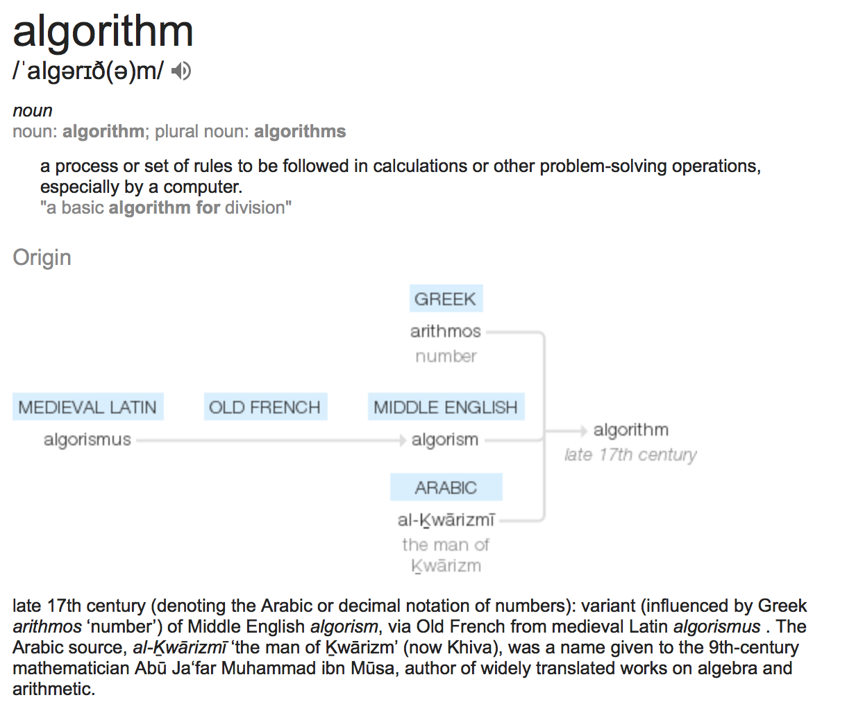
https://www.dictionary.com/browse/algorithm
Notes:
The dictionary definition is “a set of rules to be followed in calculations” with a bit more fluff around that. So it is something like a recipe to follow if we want to solve a problem.
Don’t try to figure out what the name means, it is just a reference to Muhammad ibn Musa al-Khwarizmi, a 9th century
mathematician. Algorithm is a latinisation of al-Khwarizmi and means man from Khwarizmi, similar to how Leonardo da Vinci is Leonardo from Vinci. There is no deeper meaning to the name.)
al-Khwarizmi wrote a book named “the compendium on calculation by restoring and balancing” (“al-mukhtasar fi hisab al-jabr wa al-muqabala”), which is where we have the word algebra from.
He didn’t invent algorithms — there are older known algorithms — we have just named them after him.
https://en.wikipedia.org/wiki/Muhammad_ibn_Musa_al-Khwarizmi

Slide 4
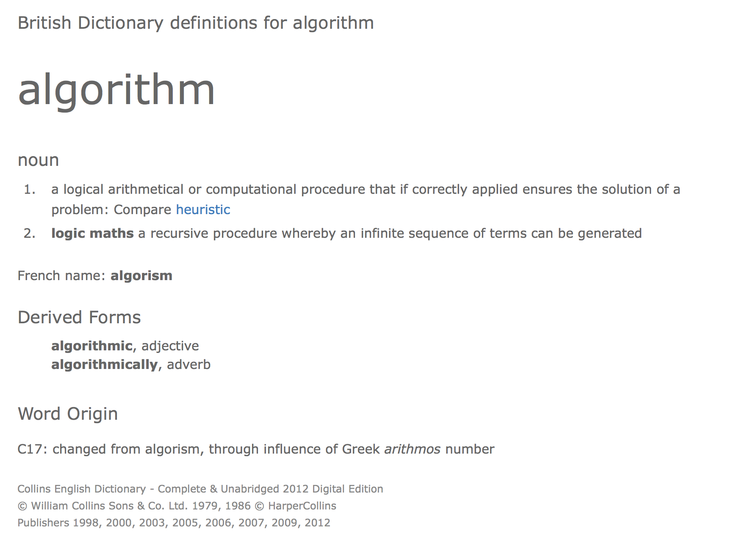
Notes:
That an algorithm is “a set of rules to be followed in calculations” doesn’t quite cut it. We are not particularly interested in just sets of rules. If we use an algorithm to solve a problem, we damn well expect it to give us a correct solution!

Slide 5
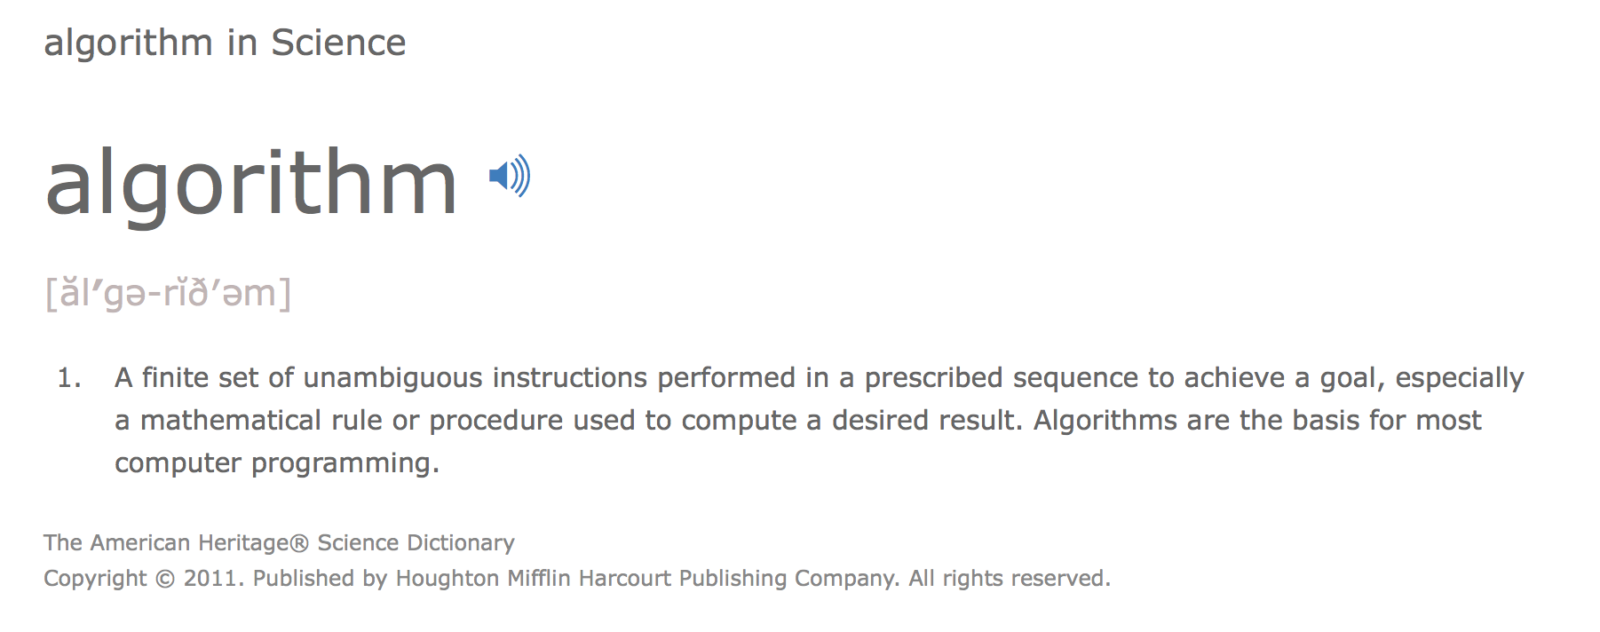
Notes:
If we shop around some more in dictionaries we also find that the number of instructions should be finite and unambiguous. We can probably agree that these are good properties as well.

Slide 6
Combining definitions…
Algorithm (noun):
A finite sequence of unambiguous steps that solves a specific problem.
Notes:
So, if we have a specific problem, an algorithm that solves it is
a finite sequence of steps to take
these steps are unambiguous — there shouldn’t be any confusion about what they do (if there is, Murphy's law is guaranteed to be in effect)
if we follow the steps exactly, we get a solution to the problem.

Slide 7
Combining definitions…
Algorithm (noun):
A finite sequence of unambiguous steps that solves a specific problem.
while True:
print("foo")
Notes:
When we say we want a finite sequence of steps, we actually require a bit more. It is possible to have a finite selection of steps that are repeated infinitely often. That won’t do!

Slide 8
Combining definitions…
Algorithm (noun):
A finite sequence of unambiguous steps that solves a specific problem.
while True:
print("foo")
We want our algorithms to terminate!
Notes:
We will not consider a recipe to be an algorithm unless we always get an answer in a finite number of steps. We say that an algorithm must terminate. Not just on some input but on all (valid) input. We make no claims about how many steps it takes to complete an algorithm—it could take nanoseconds or billions of years for we cares in the definition. We just want to know that eventually we get an answer.
Determining if a given program always terminate is a hard problem. It is impossible to build an algorithm that does this. Not just hard; it is literally impossible. This doesn’t mean that we can prove termination in special cases, and we will.
That an algorithm always terminates is generally part of the definition of an algorithm, but we do make special accommodation for programs we do not want to terminate. A web-server, for example, should not terminate. Here, on the other hand, we would rather have some guarantees that it never terminates (unless we explicitly want it to). In such cases we will still require that it handles any request in finite time (and of course that the entire process is described in a finite number of operations).

Slide 9
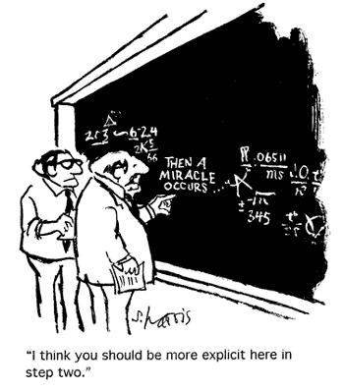
Combining definitions…
Algorithm (noun):
A finite sequence of unambiguous steps that solves a specific problem.
Cartoon from http://www.sciencecartoonsplus.com/gallery/math/math07.gif
Copied under fair use, see https://rationalwiki.org/wiki/File:Math07.gif
Notes:
Steps should be specific enough that we know we can follow them.
Feynman’s problem solving algorithm:
Write down the problem.
Think very hard.
Write down the solution.
If we leave some steps sufficiently vague not only do we leave room for errors, we have a recipe that other’s might not be possible to follow. We need enough detail that it is clear what must be done in each step. We usually stop short of reaching them level of detail a computer needs to carry out the step. That is what we do when we implement an algorithm.
Whether steps are unambiguous is a bit subjective…

Slide 10

Combining definitions…
Algorithm (noun):
A finite sequence of unambiguous steps that solves a specific problem.
Notes:
Given that we have a finite description of a problem—that will actually only perform a finite number of steps on any (valid) input—and that the description gives us an unambiguous description of what to do, we know that we always get an answer in finite time.
It would be a bonus if we always knew that the answer was actually correct!
In this class, we will make that part of the definition. We say that an algorithm is correct if it always gives us a correct solution, and correctness is something we need to prove when we develop a new algorithm.
Correctness isn’t always part of the defintion. Sometimes it is easy to check that a solution is correct but hard to actually derive the solution. Then we can have heuristics that usually give a correct answer but sometimes an incorrect one. We can combine that with a check for correctness and then we have a solution that most of the time gives us a correct answer but occasionally tells us it couldn’t find a solution.
There are other variations of heuristics where we do not always get a correct, or an optimal, solution. For this class, though, correctness is what we want.

Slide 11
Building-blocks in Programming and in Algorithms
Notes:
Before we discuss how we ensure the properties we want recipes to have to be considered algorithms, and how we approach designing algorithms to satisfy them, let us consider the building blocks of algorithms and compare them to the programming constructs we are familiar with.

Slide 12
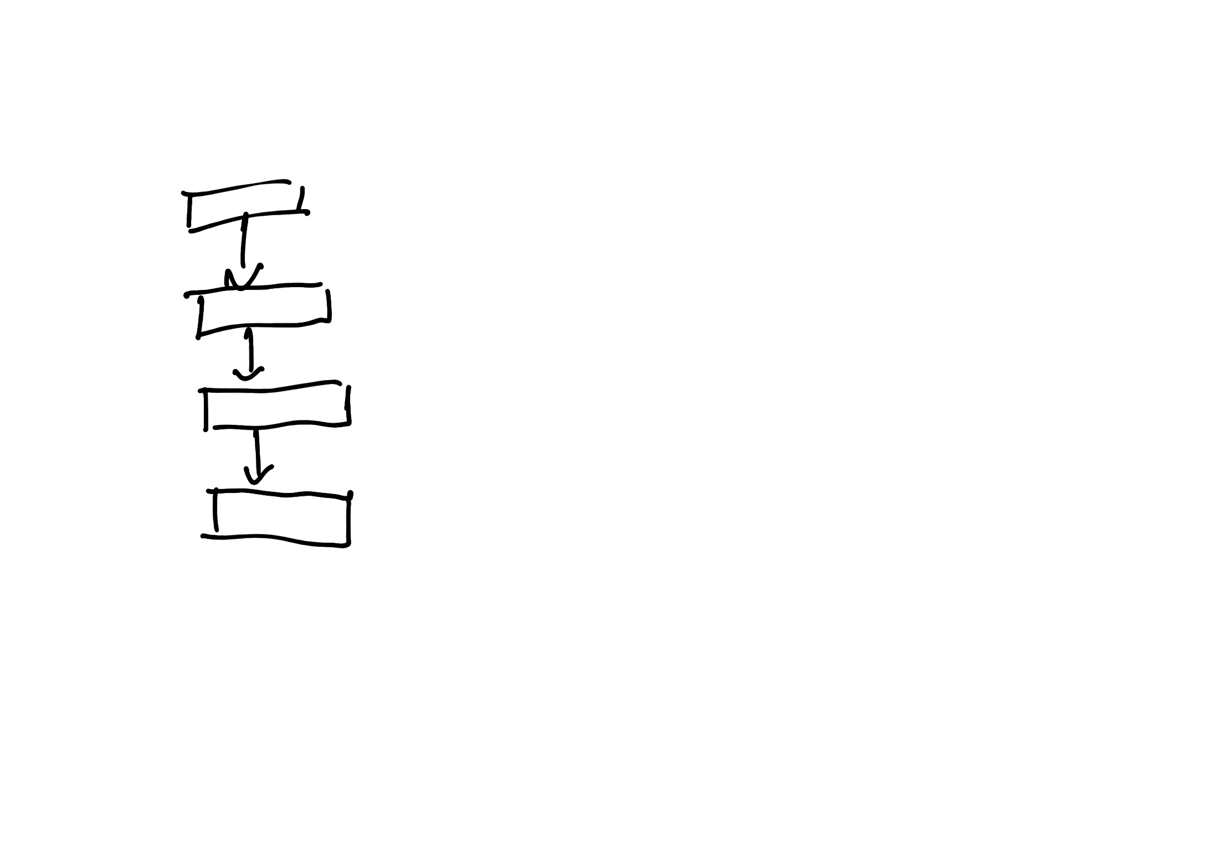
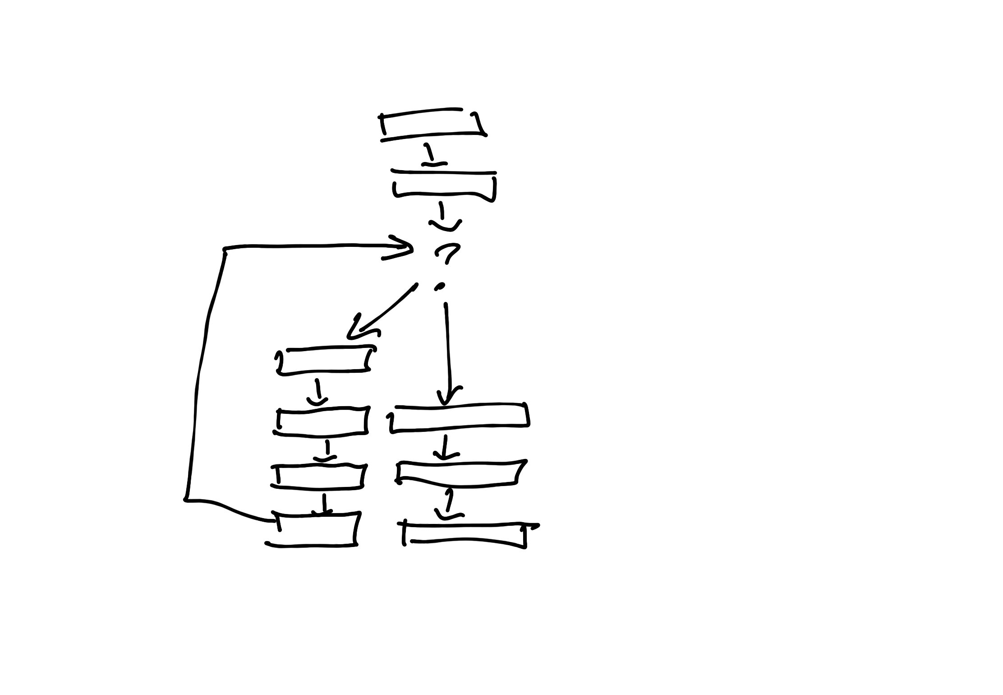
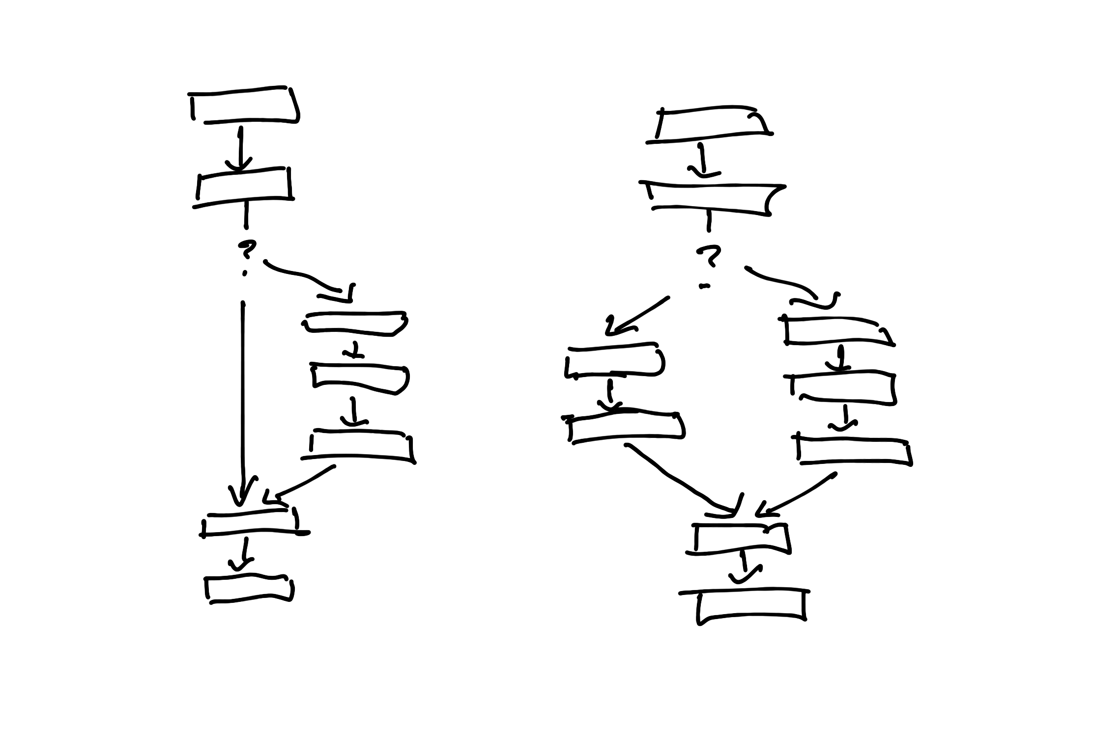
Sequential
Looping
Branching
Notes:
There are no substantial difference in the flow of operations. When we write programs, we might have high-level operations available for designing programs, but at the most fundamental level, we can do one operation after another, repeat a series of operations a number of times, or choose two different paths along a program based our program’s state. (At a more primitive level, we have conditional and un-conditional jumps between operations, but the nature of these constructions make it worth treating them as three different control-flow constructions).

Slide 13
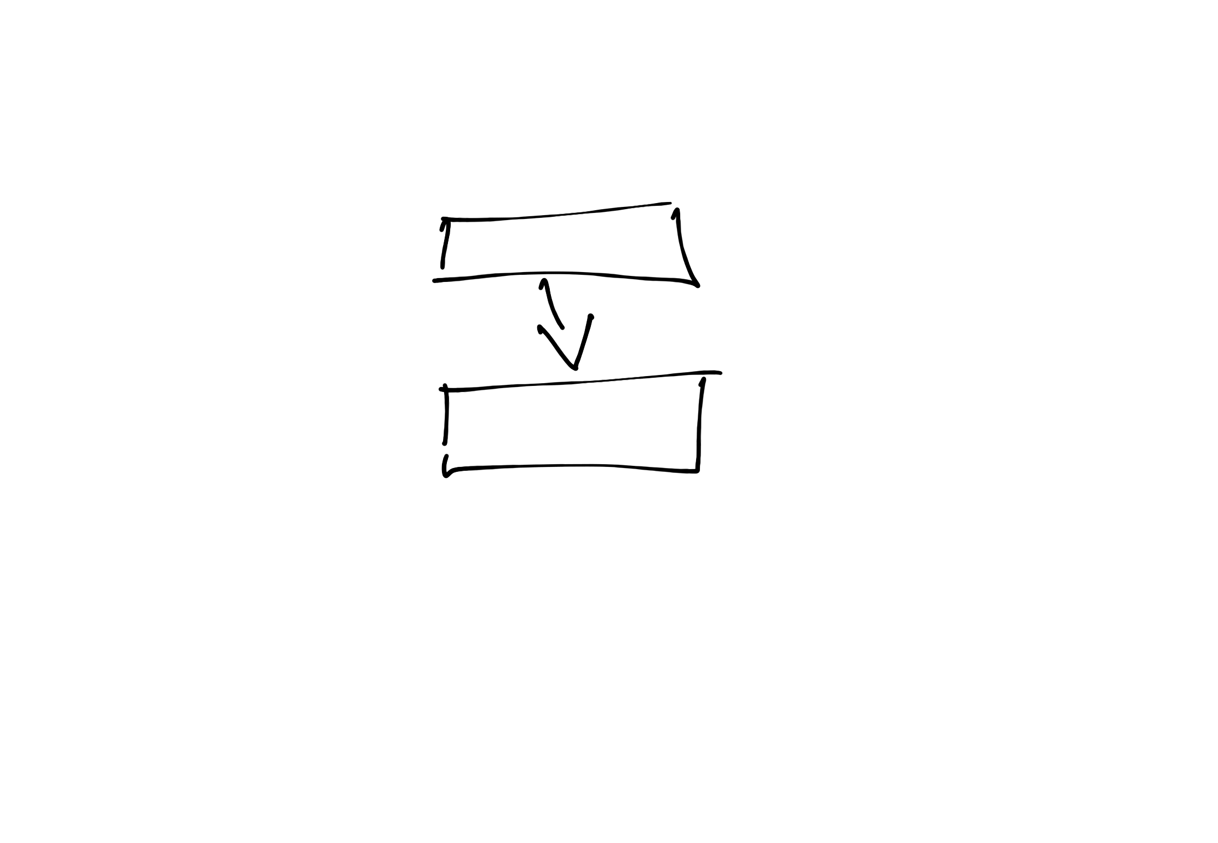

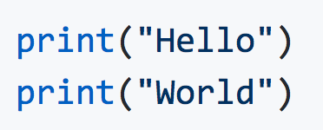
Sequential execution
Notes:
In an algorithm we can specify an order of operations where one step always goes before another. This is no different from programs where one statement goes before another. Algorithmic step are usually at a much higher level of abstraction, but otherwise there is no difference between sequential execution of a program and an algorithm.

Slide 14
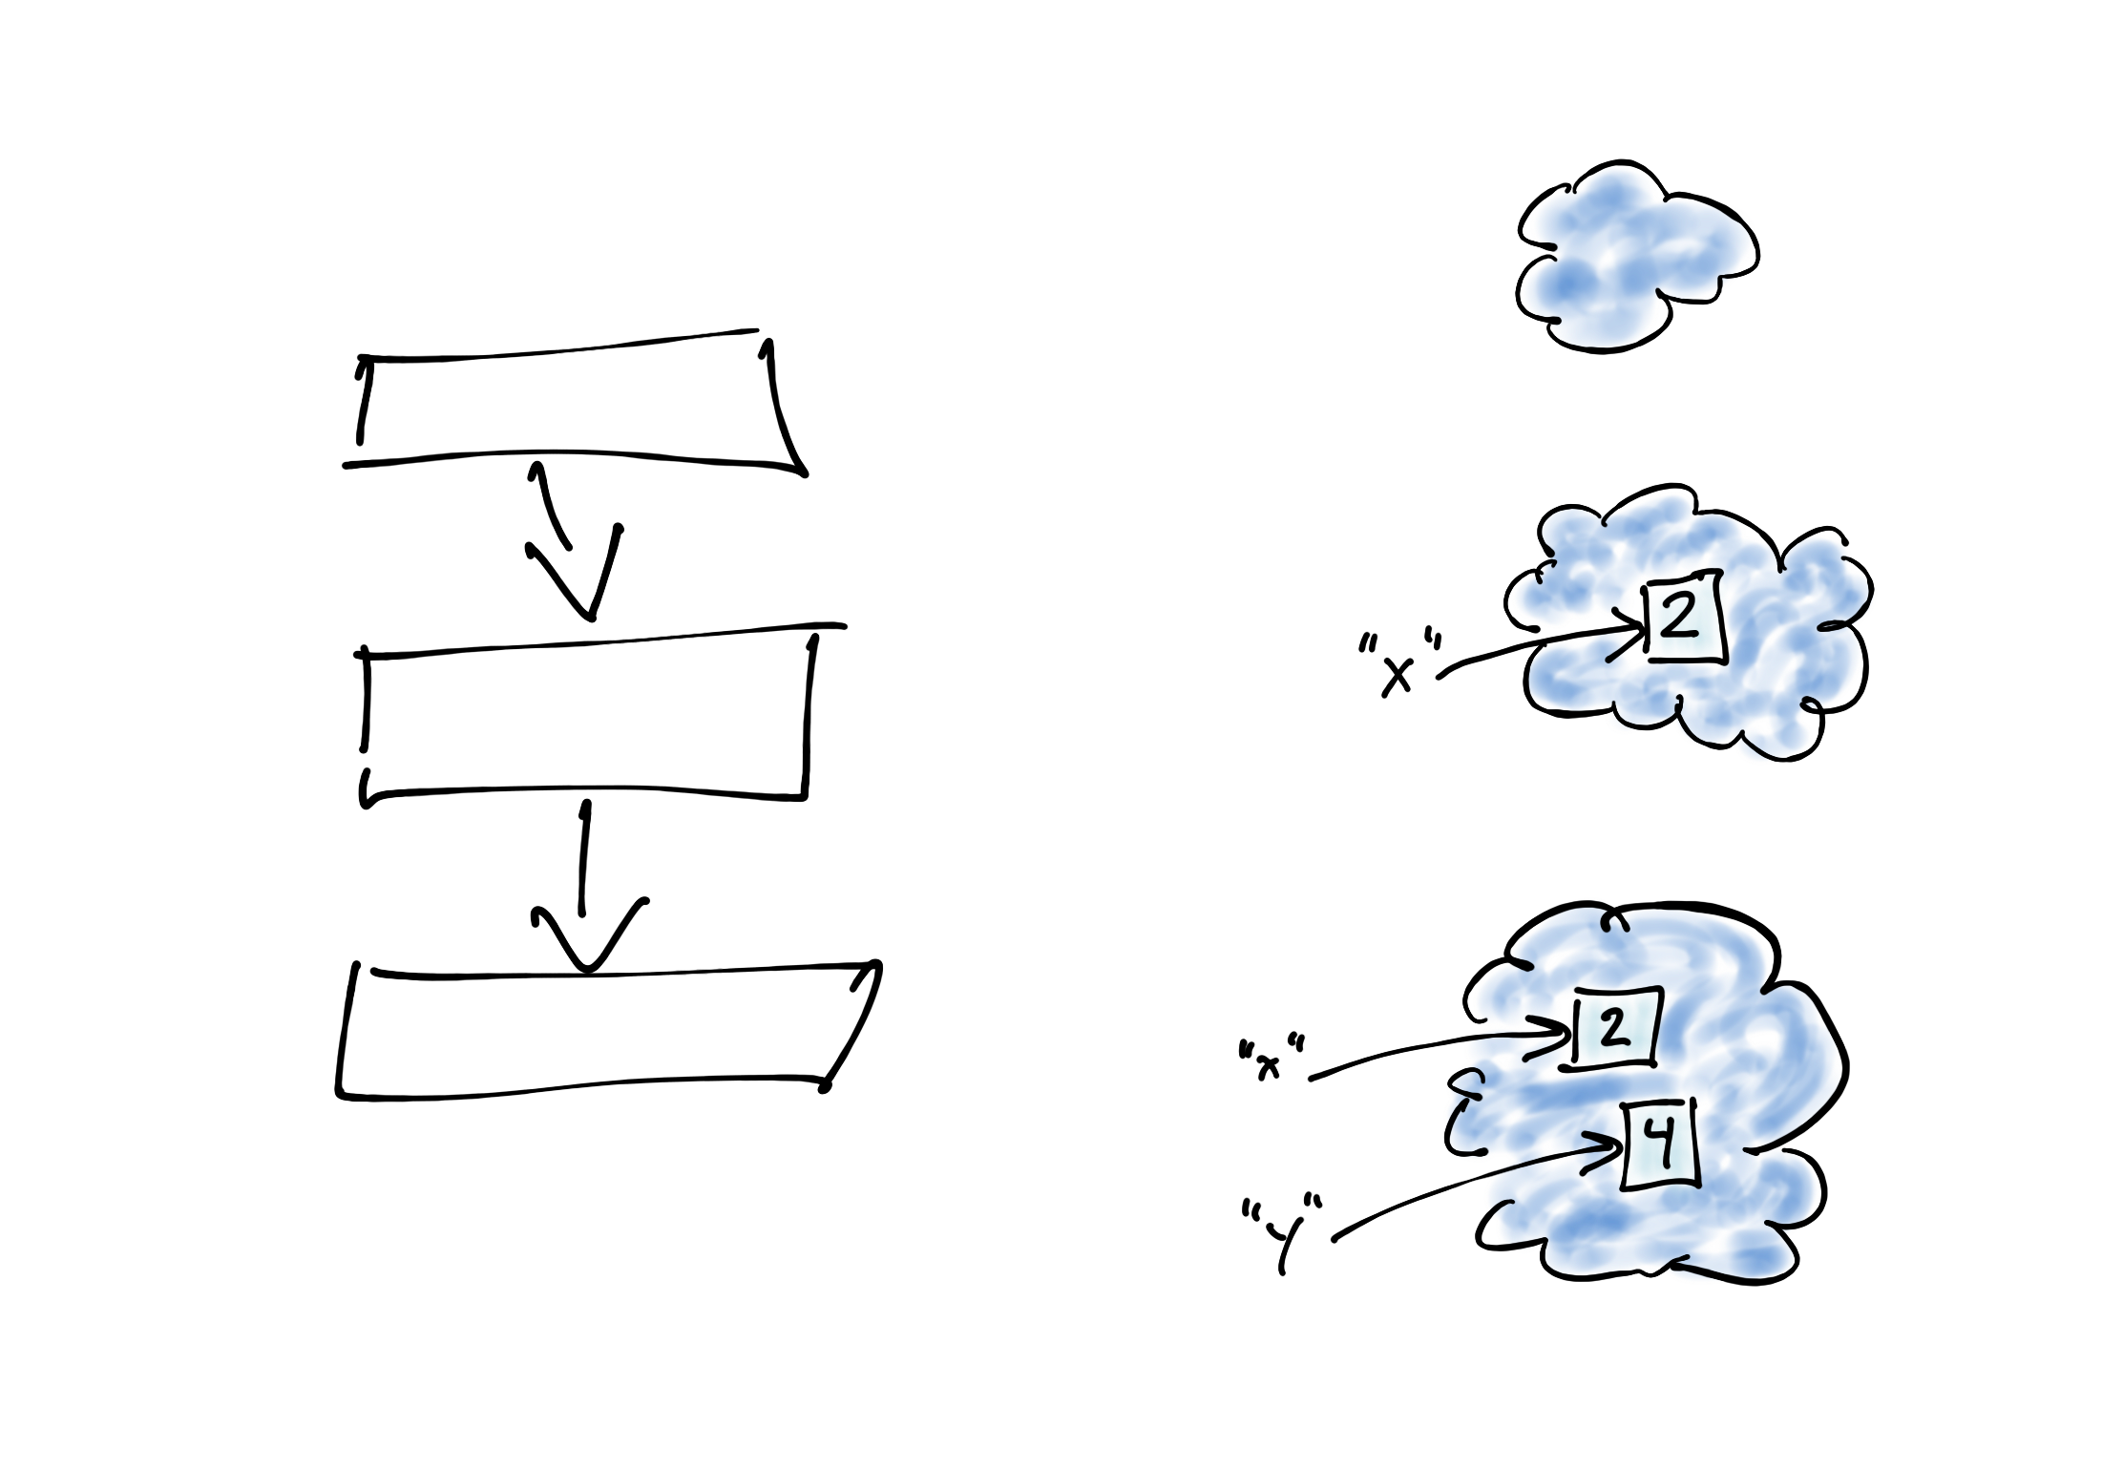

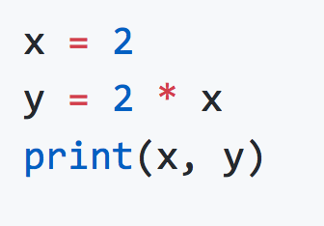
Variables (program state)
Notes:
Just as for programs, we have a concept of “state” in an algorithm. In a program, the state is is determined by which values our variables refer to and the state of these values. This is no different in an algorithm.
The values we manipulate in a program are restricted in nature based on their type; a list is always a sequence but it can be modified, a tuple is also a sequence but it cannot be modified, for example. In an algorithm we often have stronger requirements on the program state than is handled by the type information in a program, so-called invariants that we must ensure are always satisfied—more on this later.

Slide 15


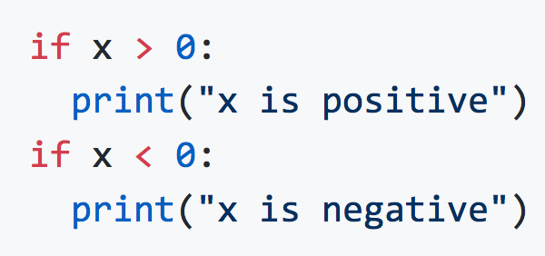
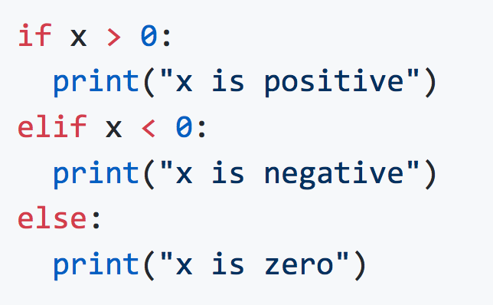
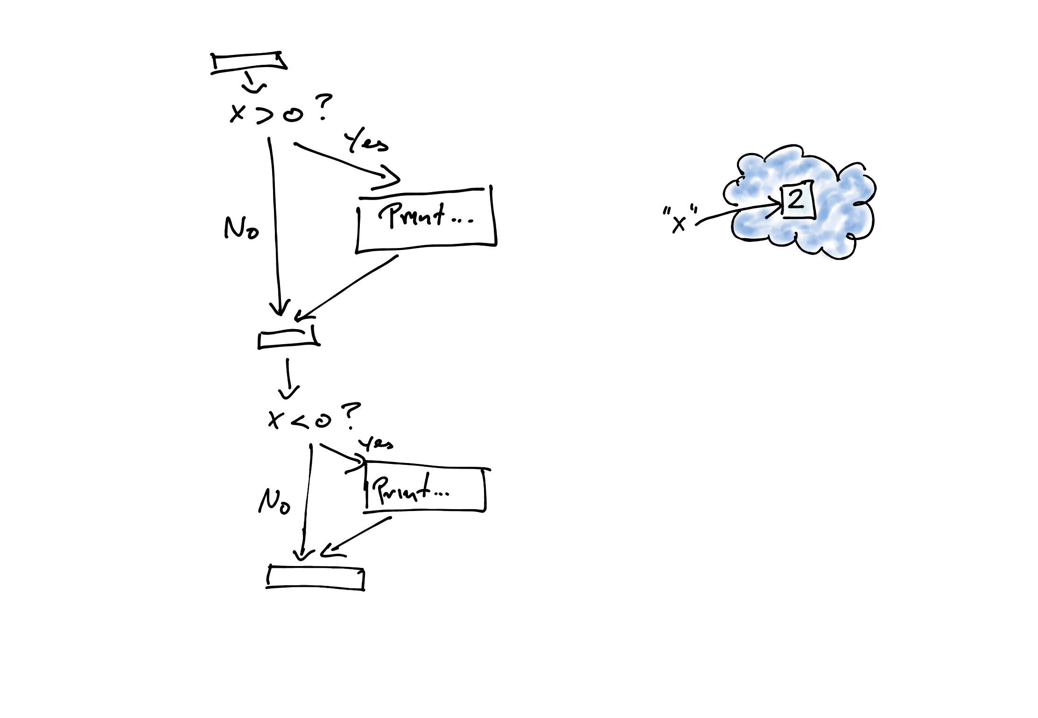
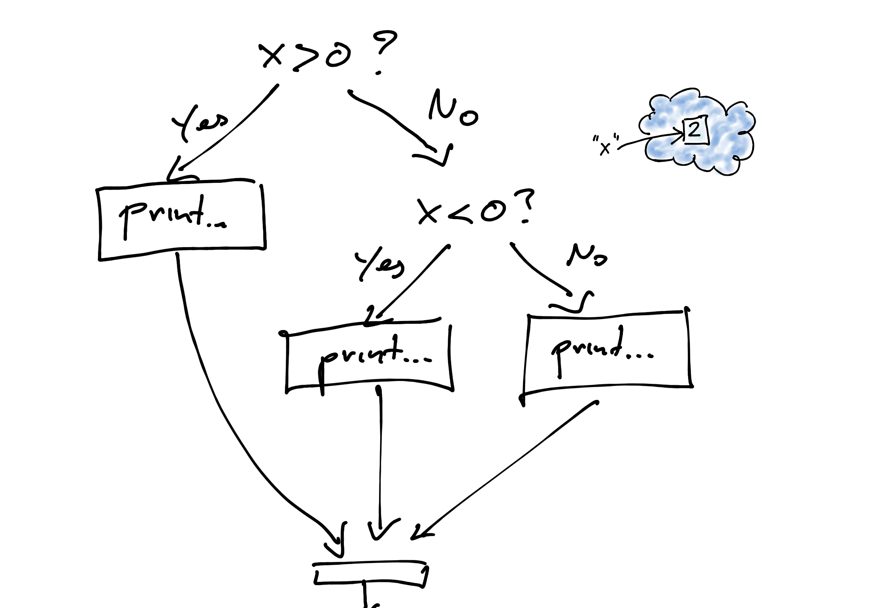
Branching
Notes:
There are no surprises when it comes to branching either; we have the same operations in an algorithm as we have for a program. Again, an algorithm often condition on more abstract properties of data than what we use in an if-statement, but otherwise algorithms are no different from programs (and more complex if-statements can readily be implemented using predicate functions).

Slide 16


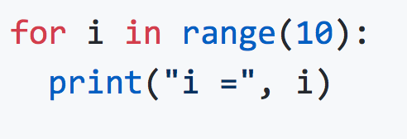
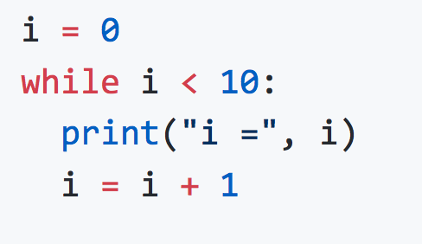
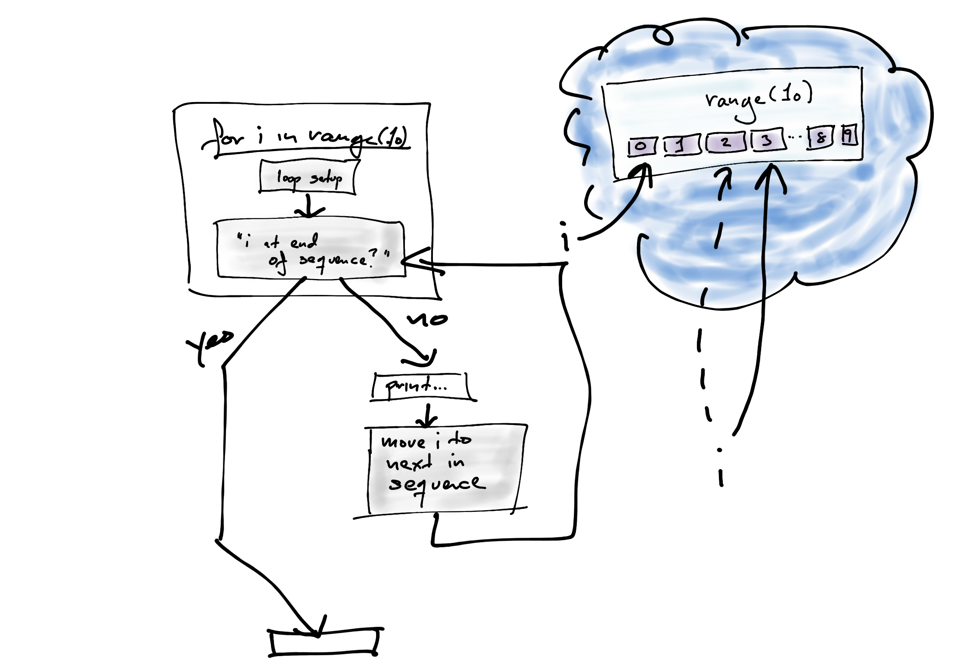
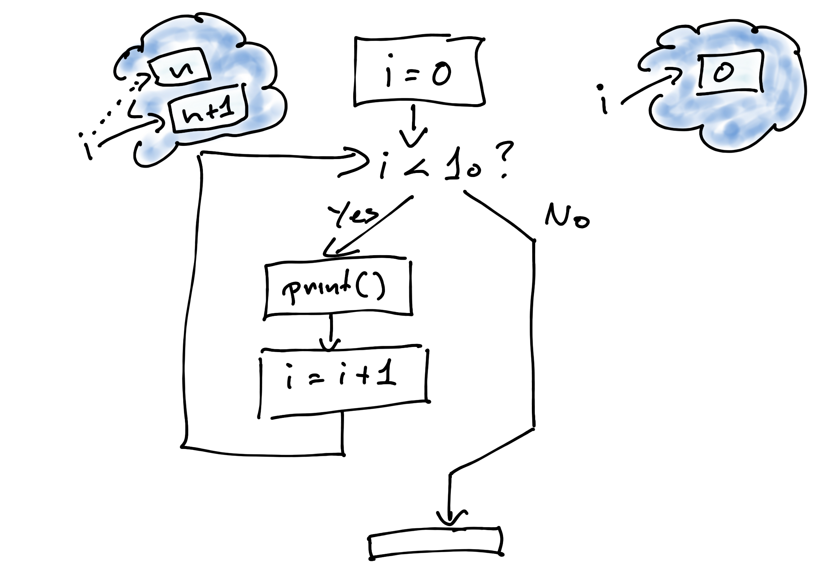
Looping
Notes:
Yeah, the difference between loops in programs and in algorithms are tiny as well.
Loops are really all the same, but there are some benefits to splitting them into two categories: those loops that are over a fixed and finite sequence of elements and those loops that continue until a predicate is false. In Python, we have for- and while-loops to express which of the types of loops we are working with.
You are not guaranteed that a for-loop is actually iterating over a finite set of elements in Python, though. The two loop constructions differ in their syntax but a for-loop is syntactic-sugar for a while-loop. Just because you use a for-loop you are not guaranteed to loop over a finite sequence. For all our uses of for-loops, however, we will loop over a finite sequence (and it requires either substantial carelessness or Python constructions we will not see in this class to change this).

Slide 17
Designing algorithms: Breaking down problems to smaller parts

Slide 18
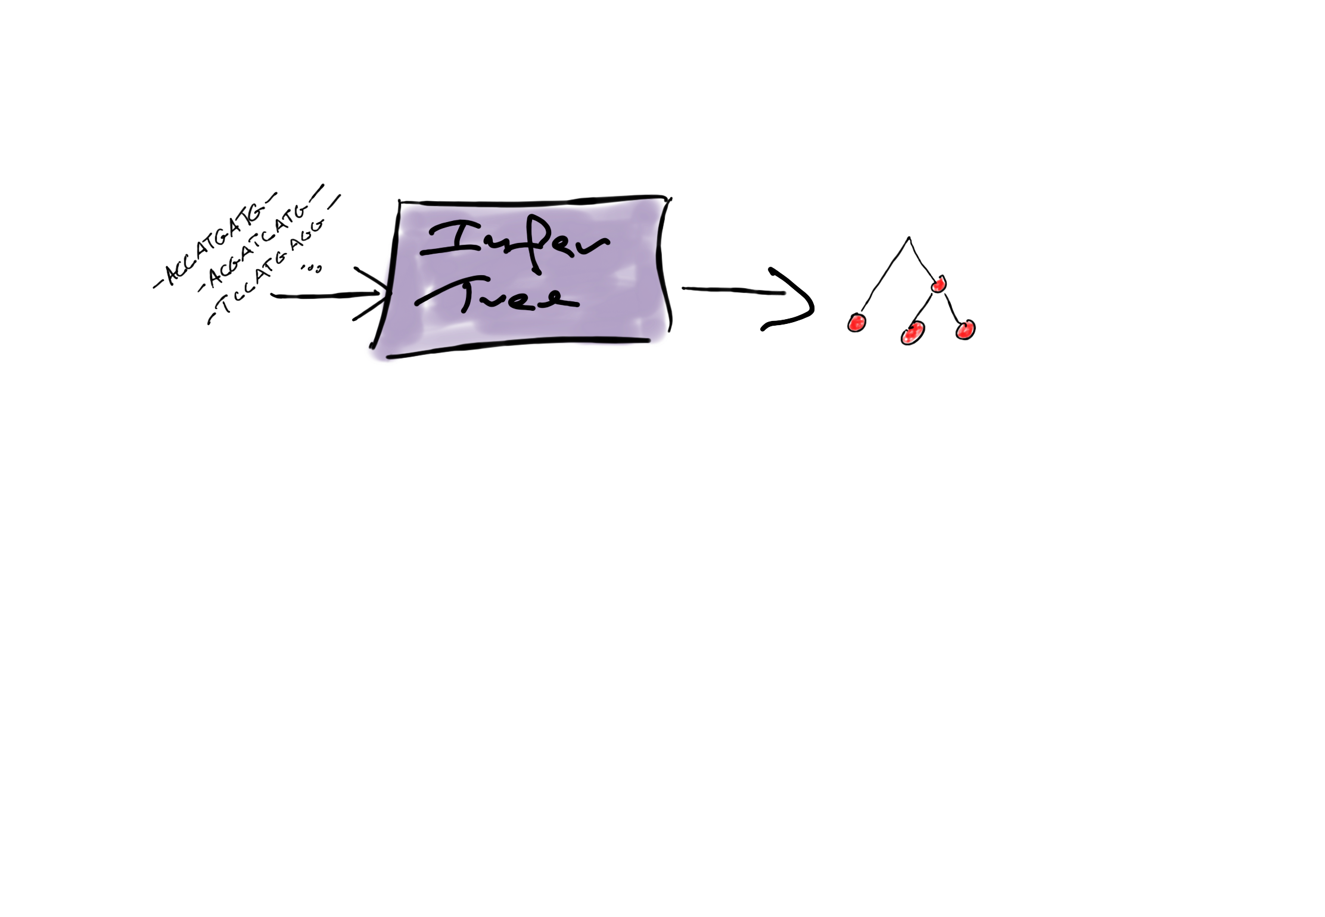
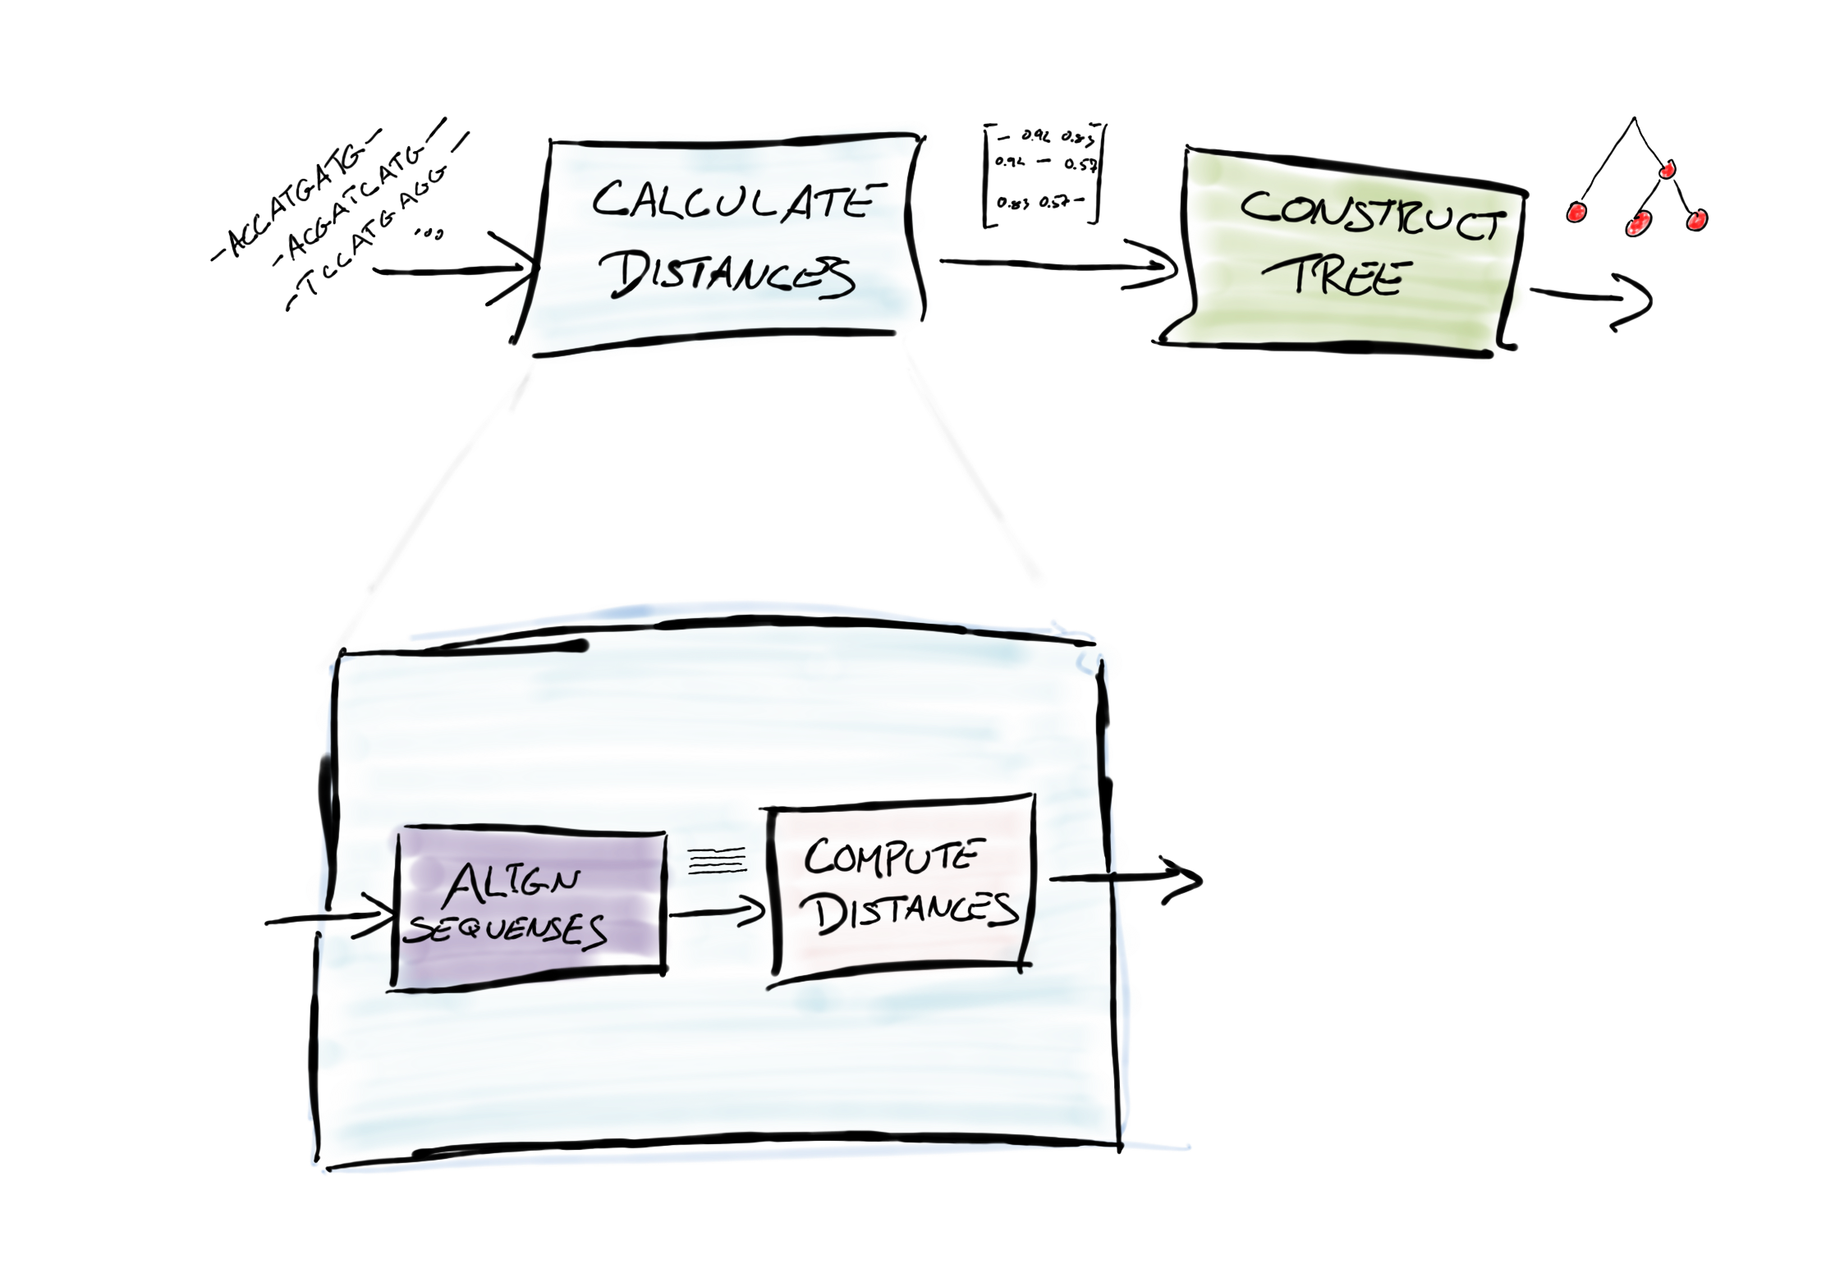
Levels of details
Notes:
They key steps in designing an algorithm is to break large tasks—which we may not know how to achieve—into sub-steps that each solve part of the problem and when combined achieve the larger task.
We usually cycle between asking "what do we want to achieve?" and "how do we achieve this?". We identify what we need the algorithm to do, for example, compute a phylogenetic tree from an alignment of DNA sequences. That is what we want to achieve. So how do we achieve it? Well, we can for example break this task into two sub-tasks: can we calculate a matrix containing all pair-wise distances between the sequences, and can we compute a tree given such a matrix? We can reduce the "Infer a tree" task into these two steps; each solve parts of the problem and if we execute the steps "Calculate distances" and "Construct tree from matrix", one after another, we have solved the "Infer tree" problem.
Now, we can ask of the two sub-tasks, exactly what do we want to achieve? We want to calculate pairwise distances in the first task and in the second we want to use these distances to build a tree (this task is an application of hierarchical clustering, in case you are interested, but we won’t explore this more here).
So, for the first task, we need to create a distance matrix. We don’t know how to do this as a single step, but we can split it into two sub-tasks, align the sequences and then compute pairwise distances from this. Both are classical problems in bioinformatics and you can find solutions there—and these solutions will consist of more detail steps.
As we move from the original task and down to more and more specific task, we flesh out the details of the algorithm. We cannot tell the computer to solve large problems directly, we must tell it how to do this. This means that we must reduce the problem into steps that we can directly tell the computer to execute. We add more and more details to the solution to a problem as we refine the tasks into more and more sub-tasks. Each time we split a task into two or more sub-tasks we make algorithmic choices and these choices will affect the result. You might want to try out several different ways of splitting up the problem, but you will always be following the same strategy: splitting problems into more and more details.

Slide 19

Levels of details
Notes:
You do not, strictly speaking, have to make each task completely independent of other tasks, but you will want to as a general rule. If you make the tasks independent, then you can solve any single task without worrying about how your solution affects the rest of your algorithm.
If we want to solve sub-problems independently, and still guarantee that they will work when we combine them, we need to be very precise in what each task needs to do, what it expects of its input, and what it promises about its output.

Slide 20
Pre-condition
Post-condition
Levels of details
Pre-condition
Post-/Pre-condition
Post-condition
Post-condition
Pre-condition
Post-/Pre-condition
Notes:
You do not, strictly speaking, have to make each task completely independent of other tasks, but you will want to as a general rule. If you make the tasks independent, then you can solve any single task without worrying about how your solution affects the rest of your algorithm.
If we want to solve sub-problems independently, and still guarantee that they will work when we combine them, we need to be very precise in what each task needs to do, what it expects of its input, and what it promises about its output. We call the demands on the input "preconditions" and the promises about the output "postconditions".
Regardless of how you perform a task, you can assume that its preconditions are satisfied, and you need to ensure that its postconditions are satisfied—other tasks later in the algorithm will depend on it.
When you combine tasks, the post-conditions of one task must guarantee the pre-conditions of the next. There is no problem if the post-conditions are stricter than the pre-conditions of the next task, but they must guarantee at least the pre-conditions of the next task.

Slide 21
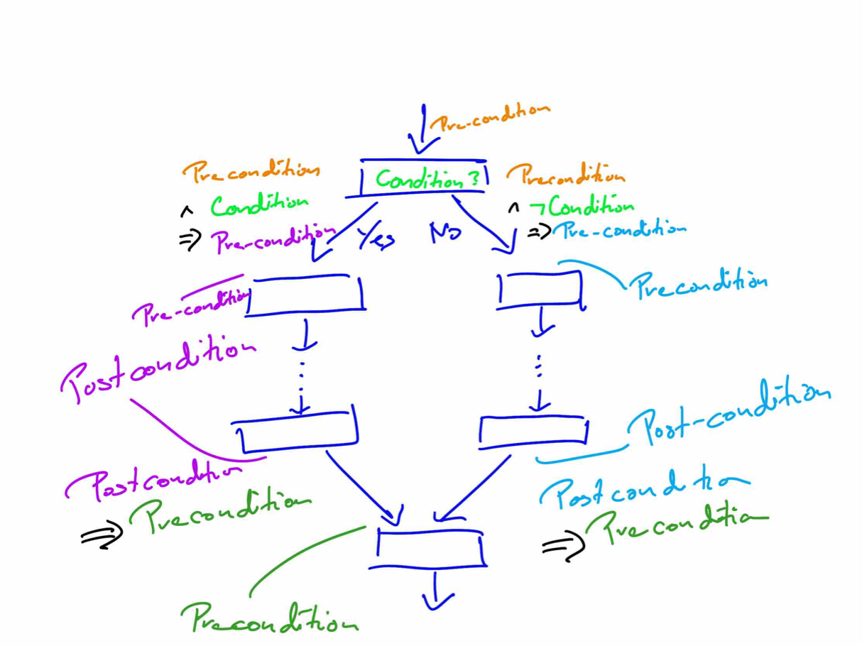
Notes:
If we have different paths between two tasks, because we have some conditional execution, then we have pre- and post-conditions that should be valid for all the paths.

Slide 22




Notes:
The pre-condition before the branch, together with the result of the branch-condition (which can be true or false), should guarantee the pre-conditions of the different branches, and the post-conditions of all branches should guarantee the pre-conditions of the point where the branches merge again.

Slide 23
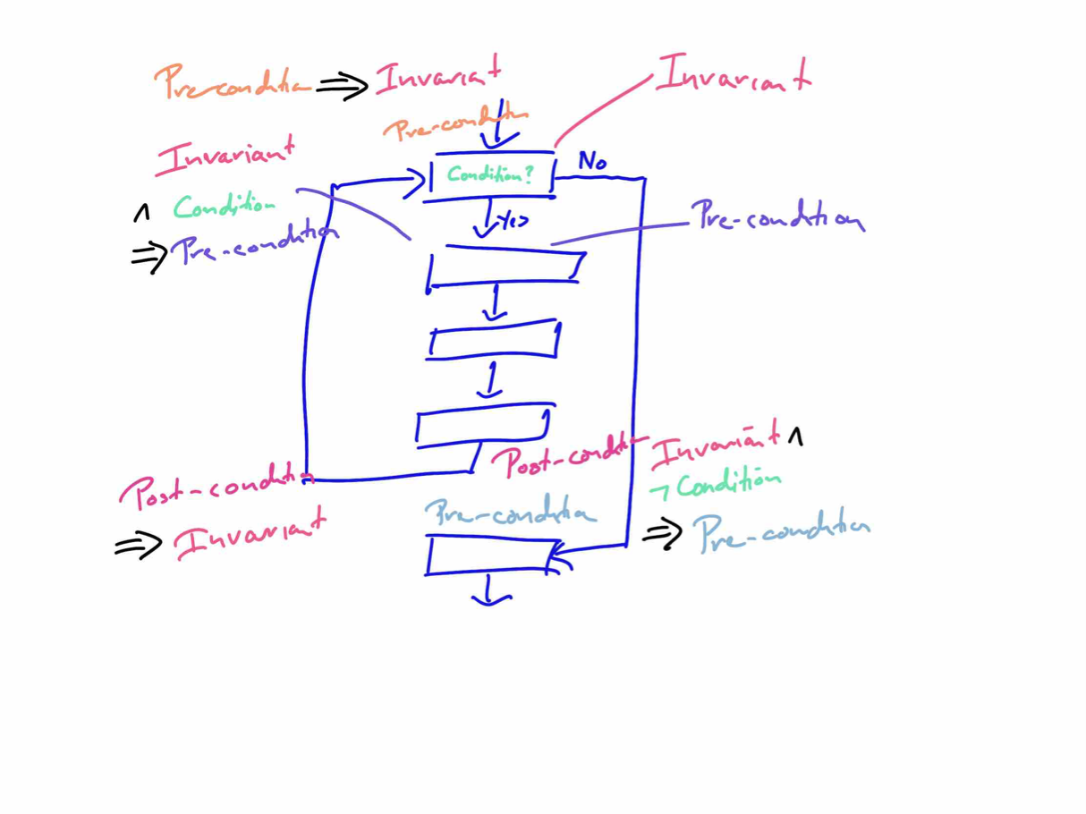
Notes:
In a loop, there are a lot of pre- and post-conditions in play. There are pre-conditions before we test the loop-condition and before we execute the first step in the loop-body. There are post-conditions at the end of the loop-body and post-conditions for when we leave the loop.
The concept "loop invariant" puts restrictions on all these conditions.
Informally, people will say that a loop invariant should always be true inside a loop, but this isn’t strictly true. It can be violated at any point inside the loop body; it just needs to be true before and after executing the loop body. The loop invariant work with the conditions shown in the figure.

Slide 24

Notes:
We require that the invariant is true before we even test the loop-condition. This guarantees that the invariant is true whenever we make this check, regardless of whether it is when we first reach the loop or when we return to the test after executing the loop body.

Slide 25


Notes:
If the loop-condition is true and the invariant is true, then that should guarantee that the pre-conditions for the first step in the loop body are true.
Whenever we finish the loop body, the invariant must also be true. This means that the post-conditions of the last step in the loop body must guarantee the invariant. After the last step inside the loop body, the loop condition can be both true and false (if it is always true we will never leave the loop); we do not require that it is true from the post-condition of the last statement—only that the invariant must be true.
It is because the invariant must be true before and after we enter the loop body that we say that it must always be true for a loop—the language is a bit imprecise but what we mean is that the invariant fits the pre- and post-conditions of the loop body in this particular way.

Slide 26

Notes:
When we leave the loop, the loop-condition will be true—otherwise we wouldn’t leave the loop—and we require that the invariant is also true. These two conditions, combined, can be seen as the post-condition of the entire loop and they should guarantee the pre-condition of the first statement after the loop.

Slide 27
Example: are cities A and B connected?

Slide 28
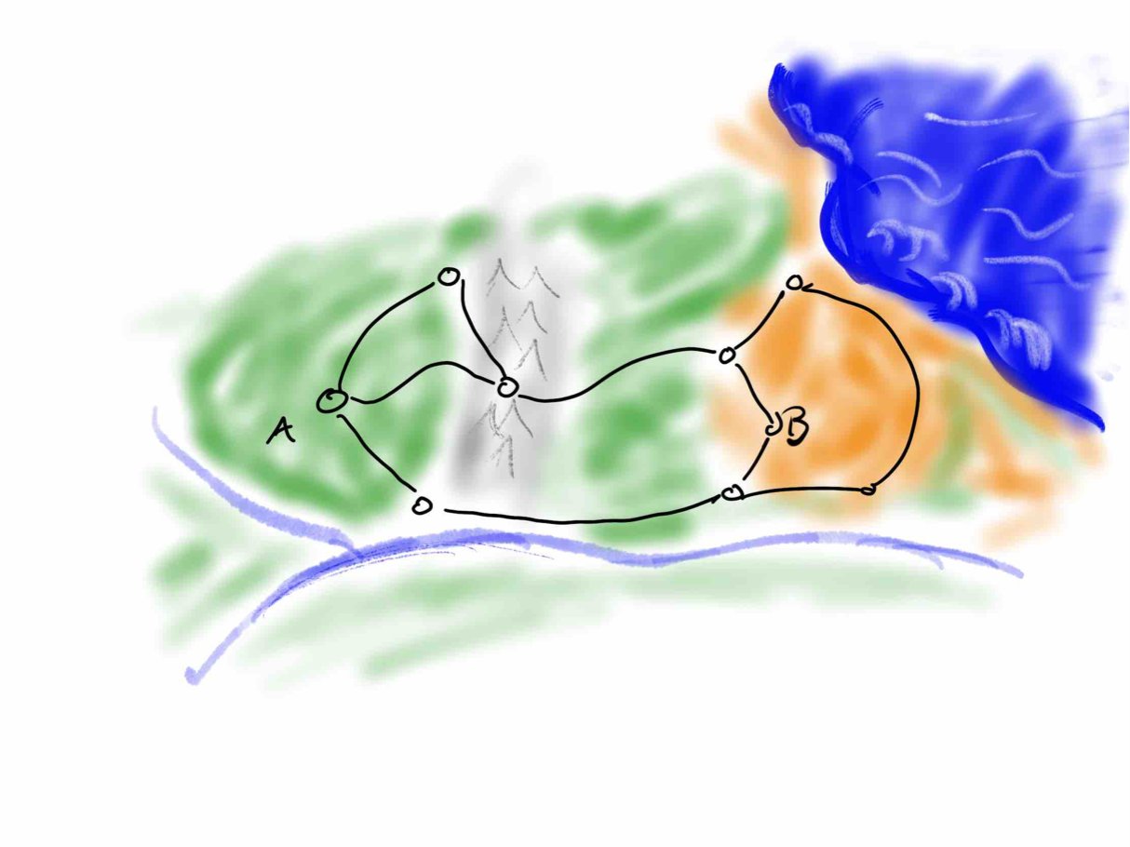
Notes:
Consider a map — I know I am not earning any art-points here, but I do my best.
The map includes roads between cities and we are interested in knowing if it is possible to get from city A to city B by road.
There are no cities on earth that you cannot reach from any other, but you cannot go by road between all pairs of cities. It is a bit of a made up problem, but it is not unrealistic (and it does pop in many applications where we are interested in connections between items that are not cities).

Slide 29
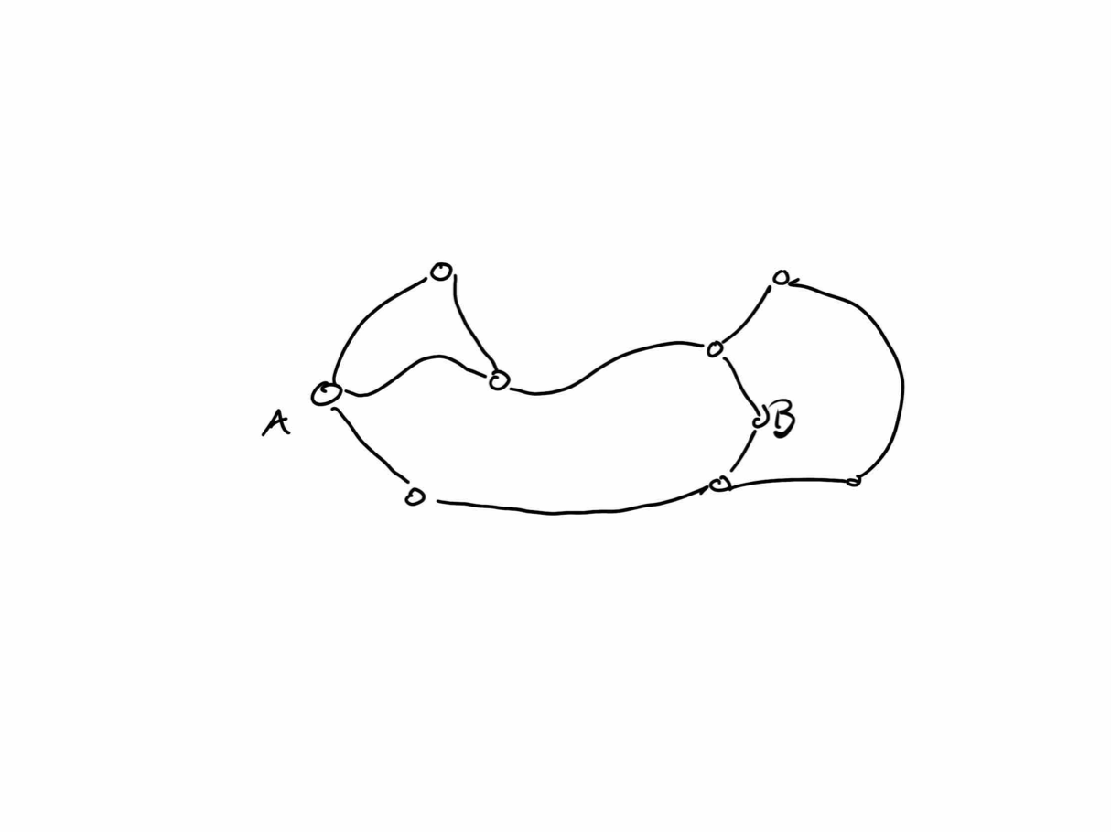
Notes:
The actual map doesn’t matter. Only the connections between cities that the connect pairs of cities.

Slide 30
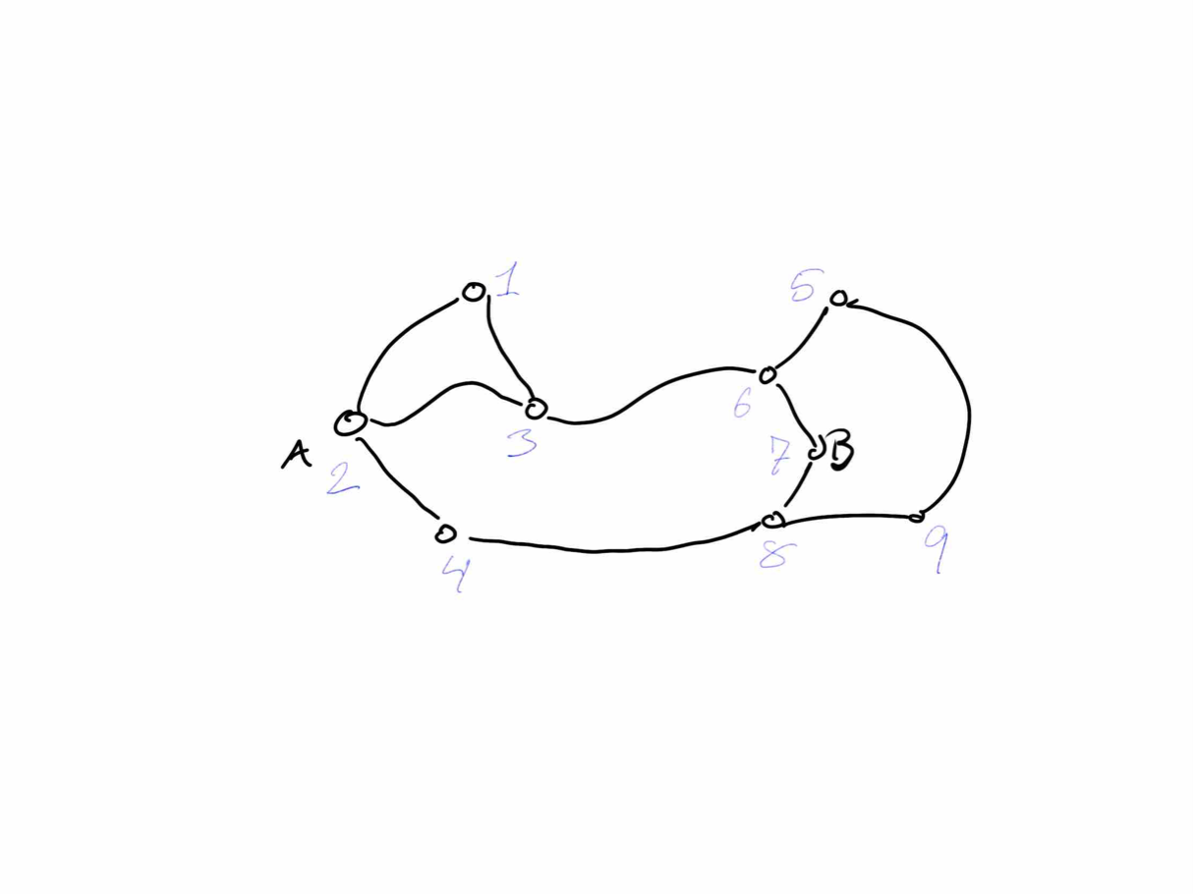
Notes:
We can number the cities, so we can refer to them without pointing at the map.

Slide 31
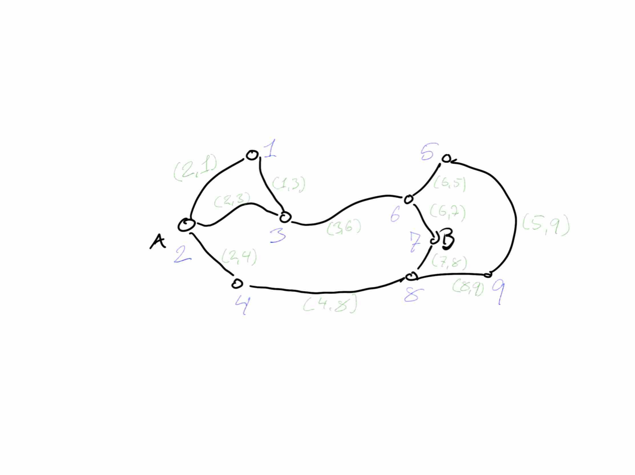
Notes:
And we can represent all the roads by the pair of cities they connect. We consider (a,b) and (b,a) the same; we do not care about the order.
A structure that only consists of nodes and direct connections between them is usually called a graph.

Slide 32
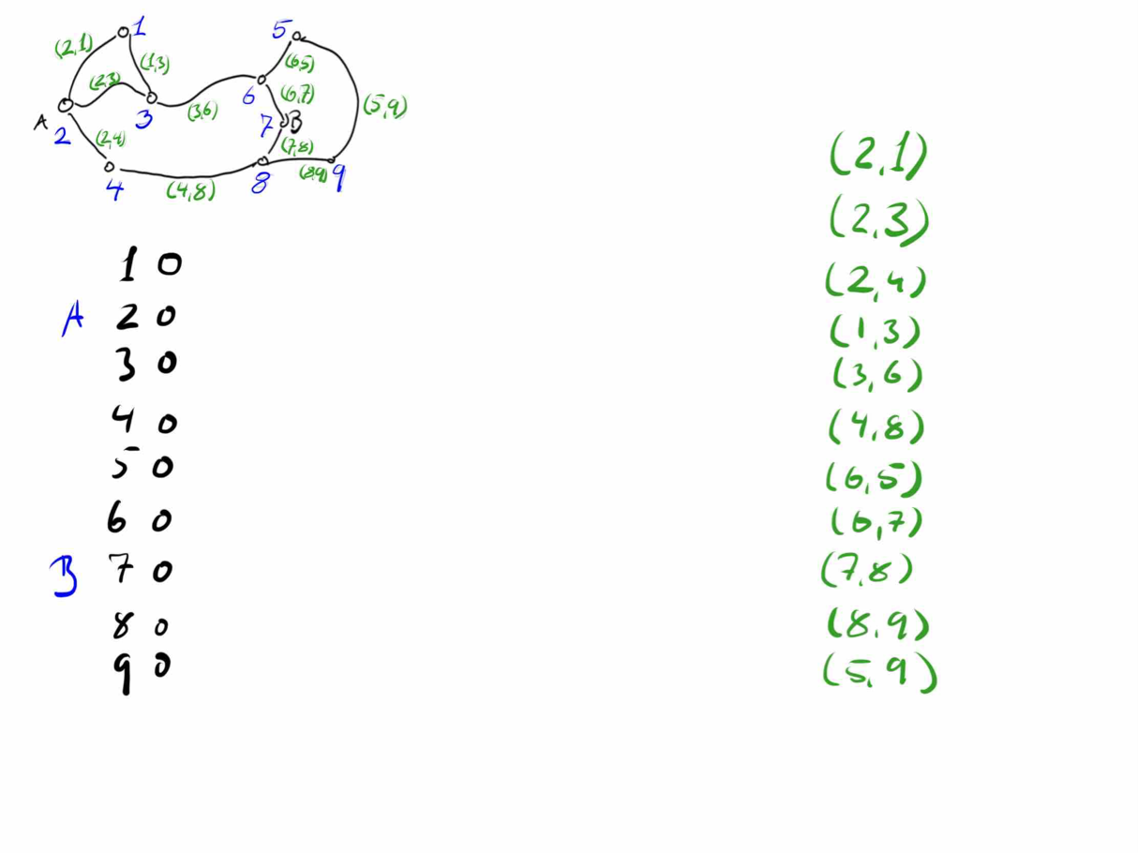
Notes:
We have simplified our data to something that is easier to give to the computer and perhaps also easier to manipulate in a program.
We can also change the question from "are A and B connected?" to "are A and B in the same connected component?"
A connected component is a set of graph nodes where you can get from any one node to all the others. We will derive an algorithm that maps each node to a connected component; once we have this map, we can decide if A and B are connected by checking if they are in the same component.

Slide 33
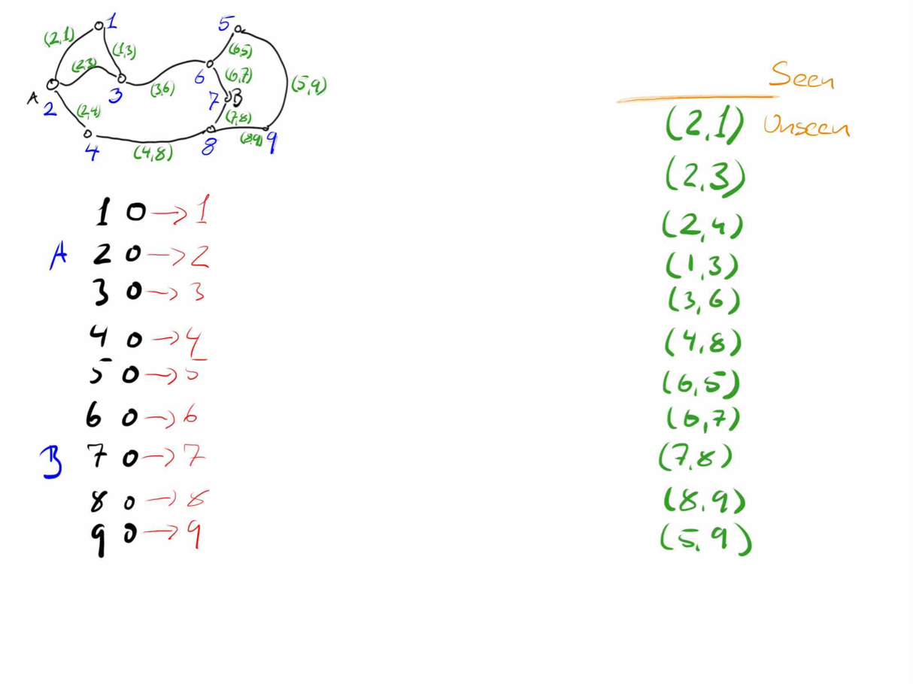
Notes:
We will represent the connected components by a "canonical representative": the city with the smallest number in the component. We will have each city point to the representative of its connected component.
We will iterate through the roads and we will have the following invariant:
All cities know their connected component assuming that the graph only had the roads we have seen so far.
Before we start the loop, each city must point to itself (all components are singletons if there are no connections).
After each loop-iteration we must have updated the components according to the new road.

Slide 34
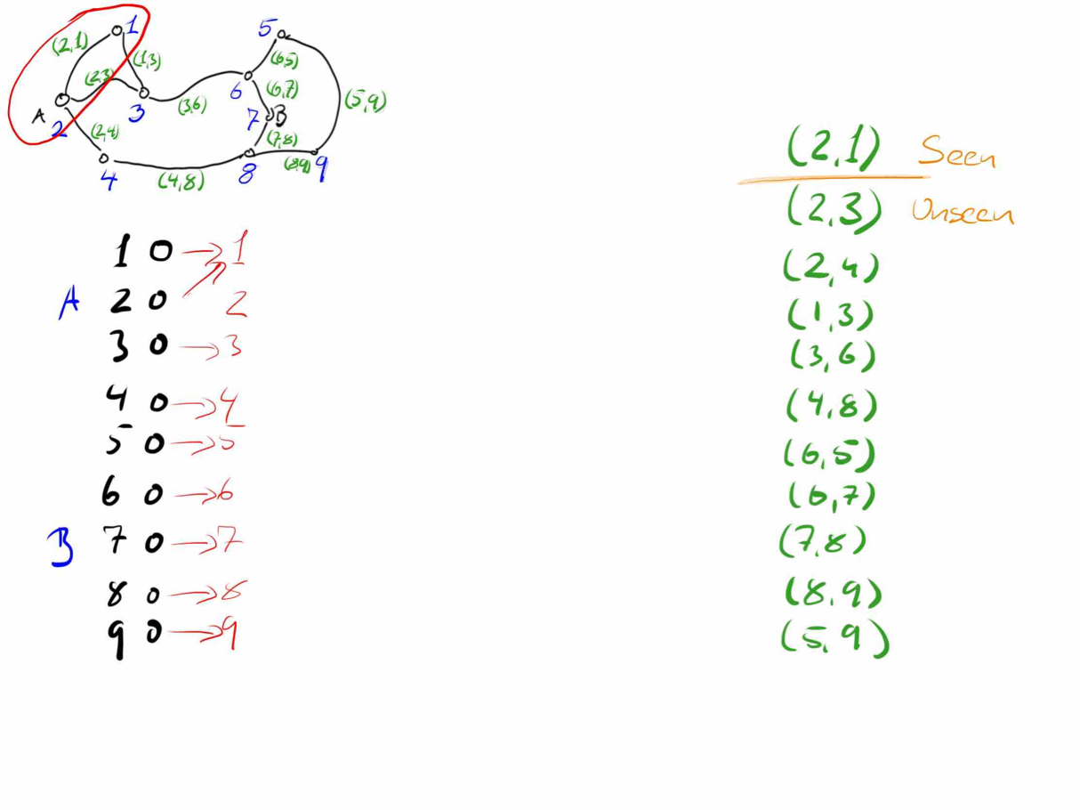
Notes:
When we see a new road, we have to connect two components. Since we represent components by the smallest index in them, we need to make all the cities in both components point to the smallest index in the two components. (Do not worry about the details of how to do this for now; it suffices to know that this is what we must do).

Slide 35
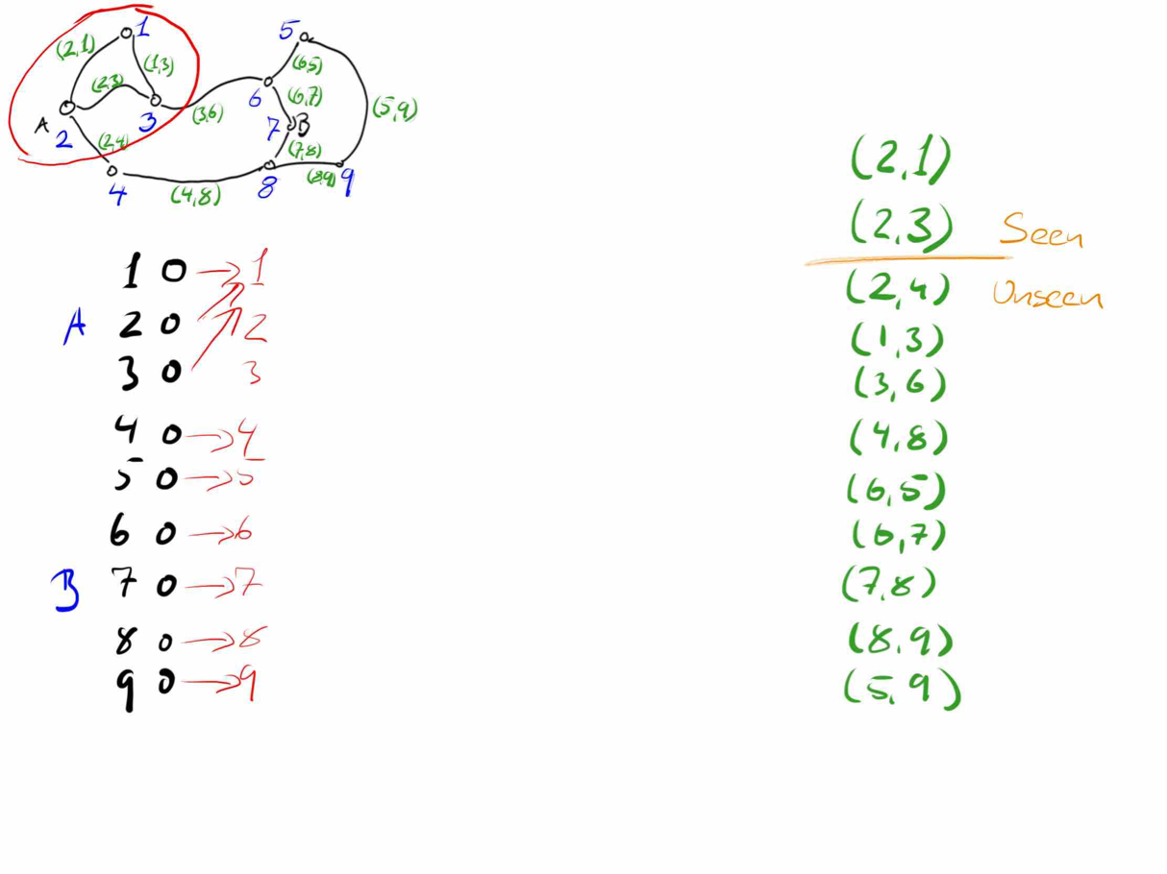
Notes:
We keep updating the components according to the roads we see…

Slide 36
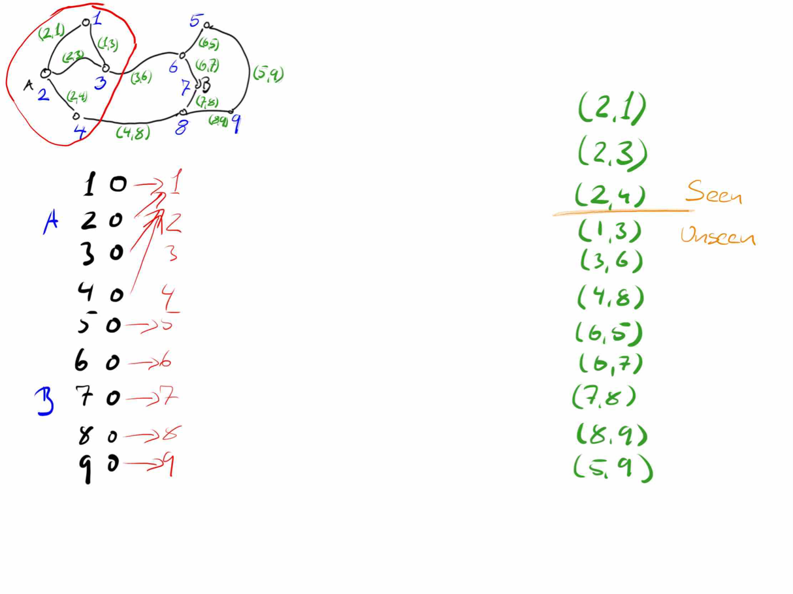

Slide 37
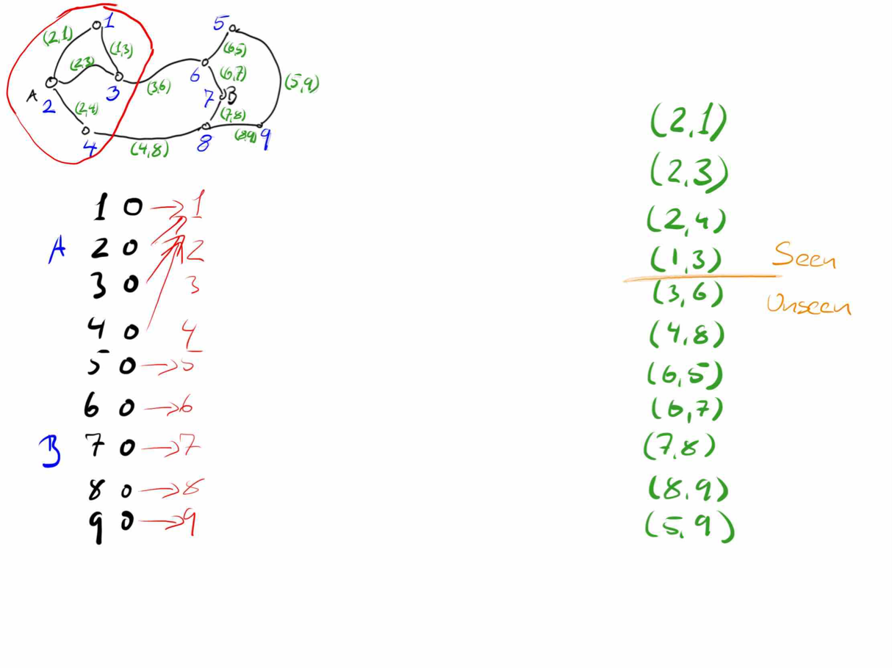
Notes:
Not all roads will change the components. If we have a road between two cities that are already in the same connected component, then we do not update anything.

Slide 38
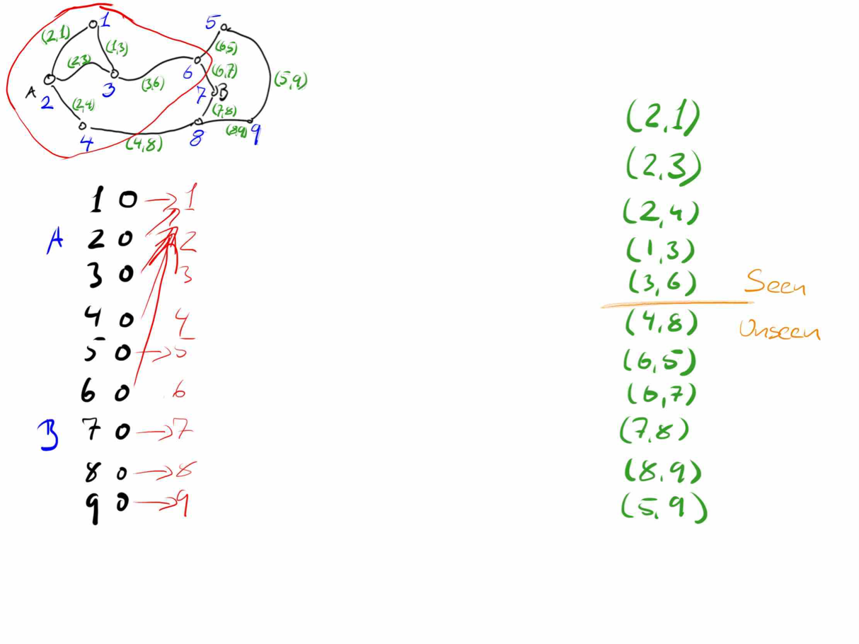

Slide 39
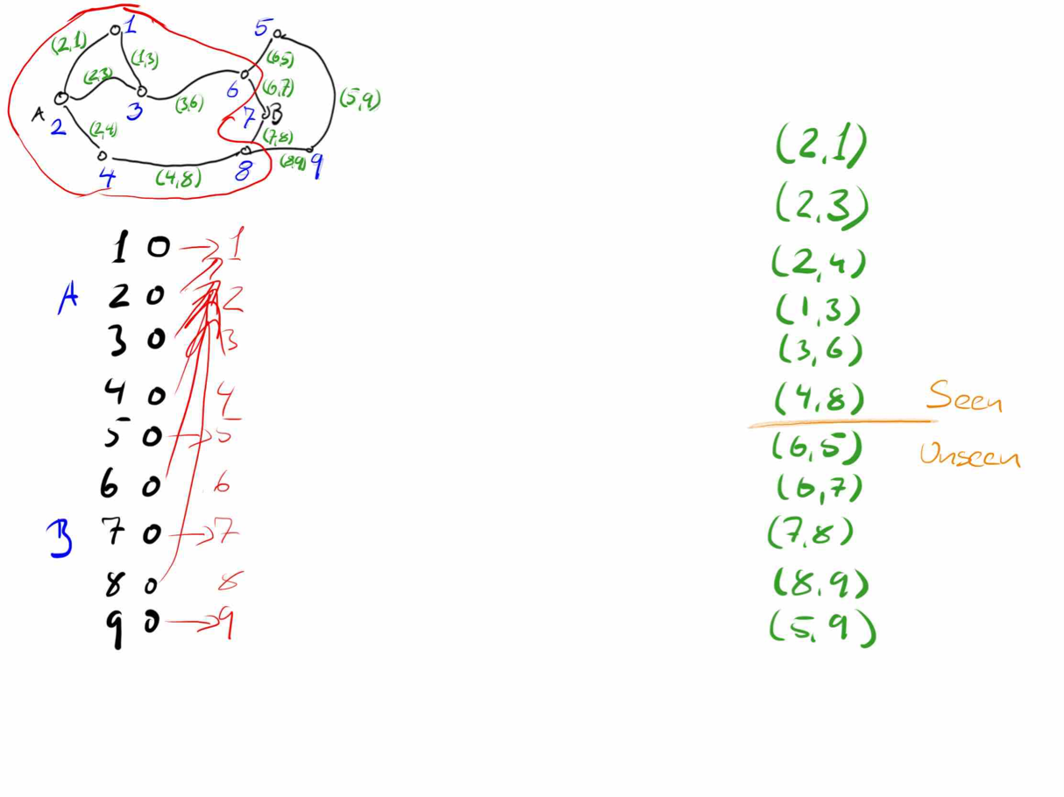

Slide 40
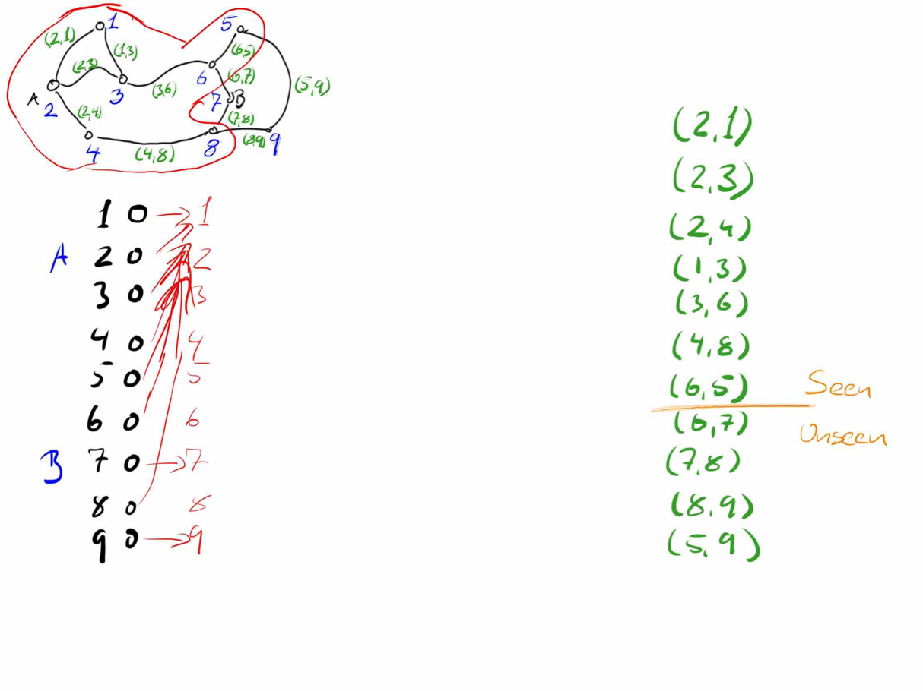

Slide 41
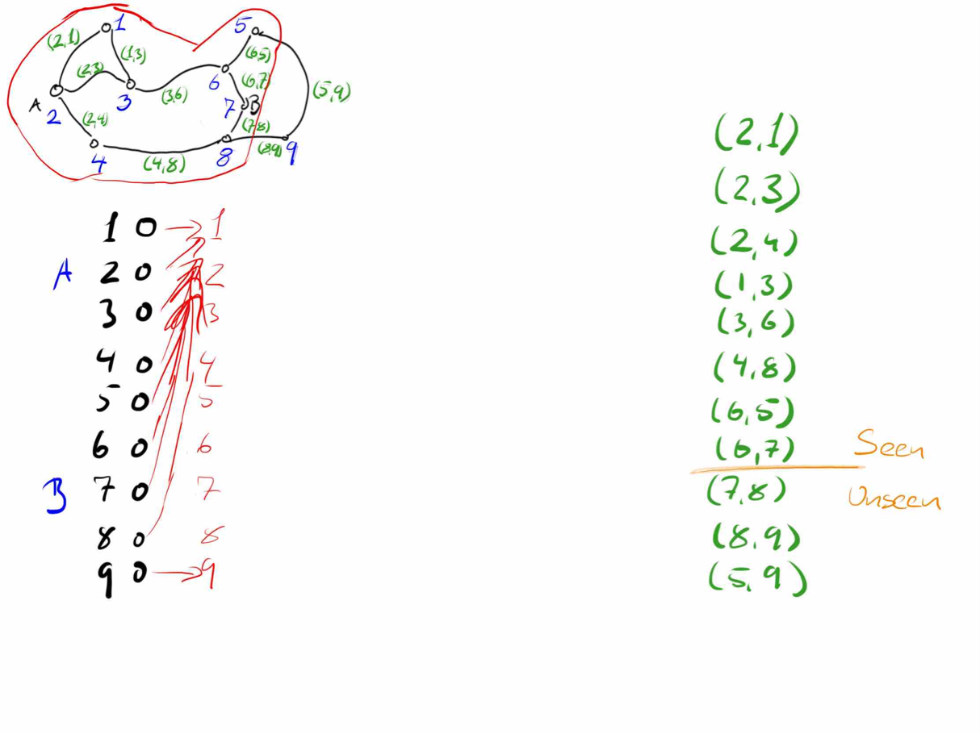

Slide 42
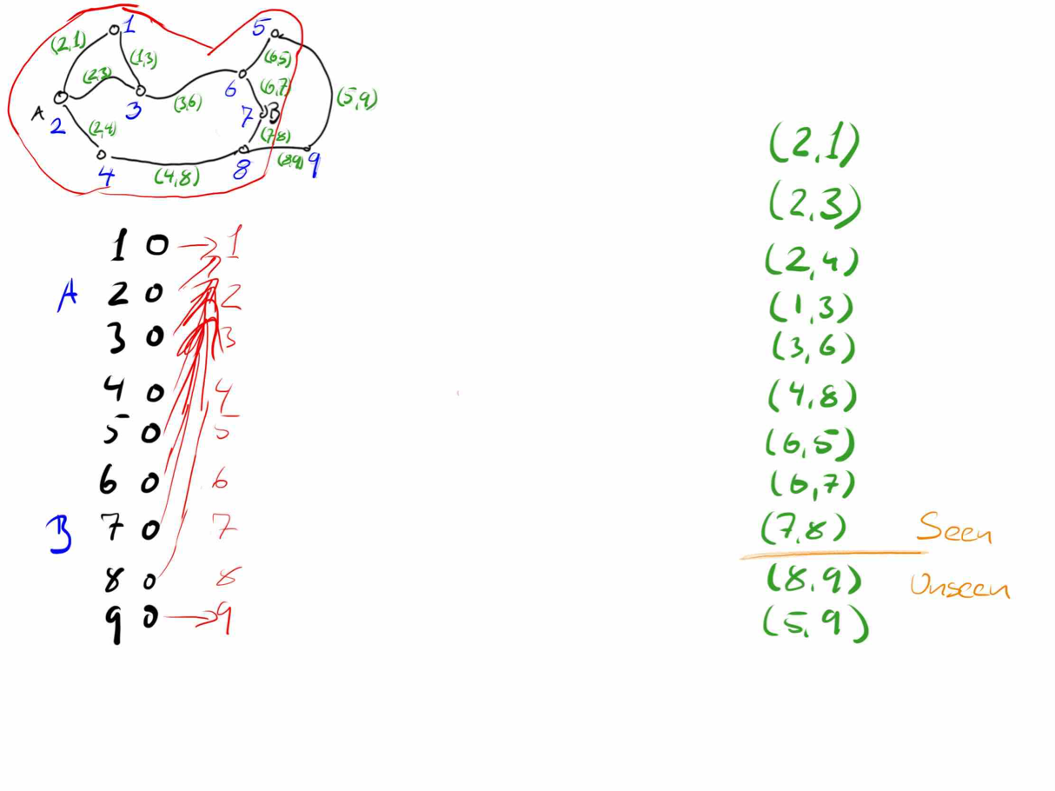

Slide 43
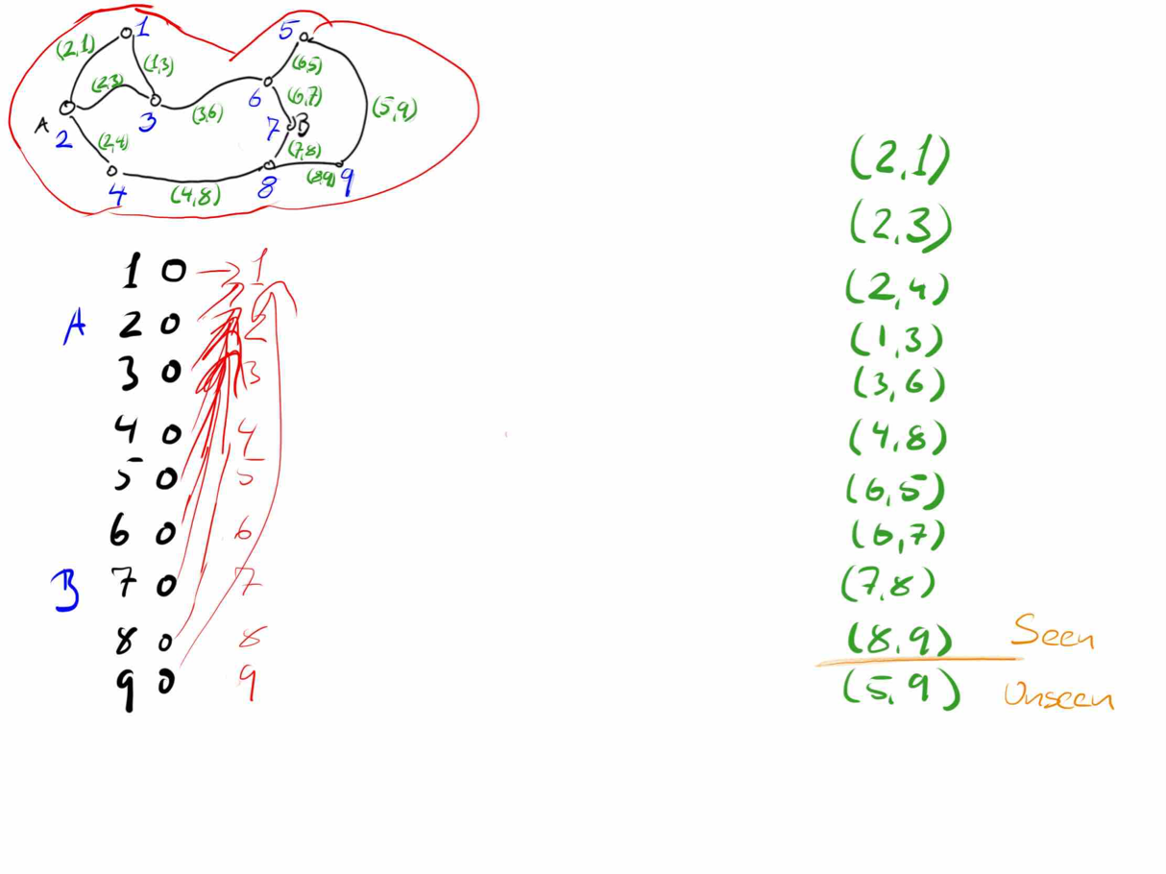

Slide 44
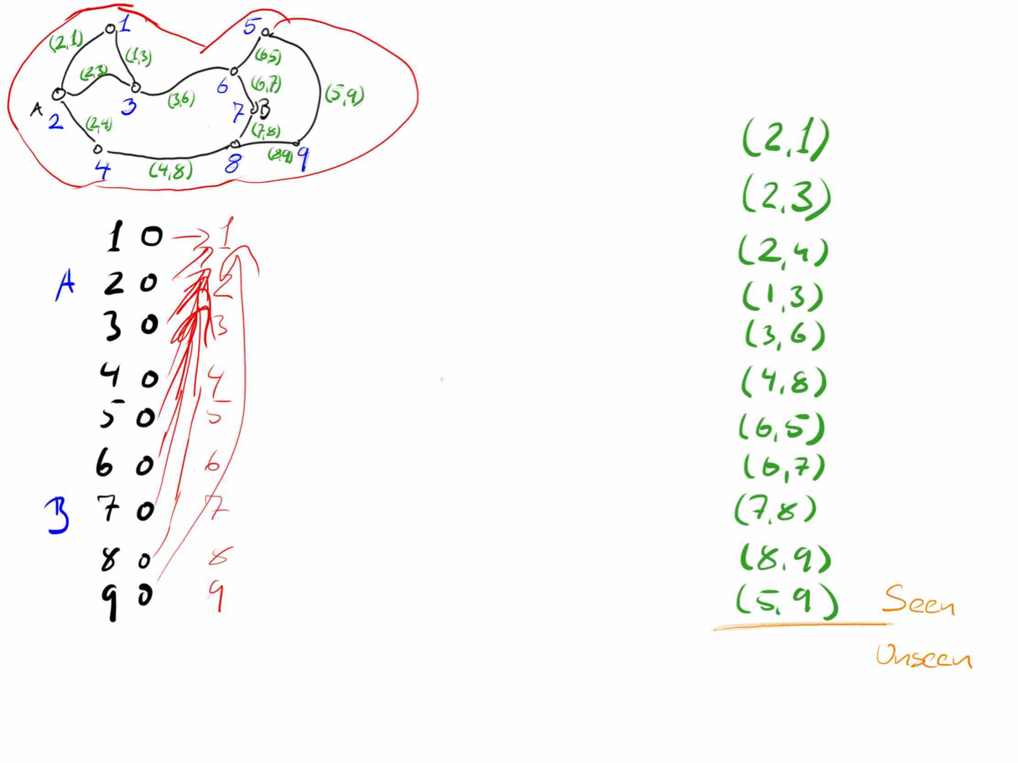
Notes:
Once we are done scanning through all the roads, we can simply ask if city A — index 2 — is in the same component as city B — index 7 — and we see that they are.

Slide 45
Intermezzo
How would you represent the components in Python?
How would you formalise the loop invariant to take into account the representation of the components?

Slide 46
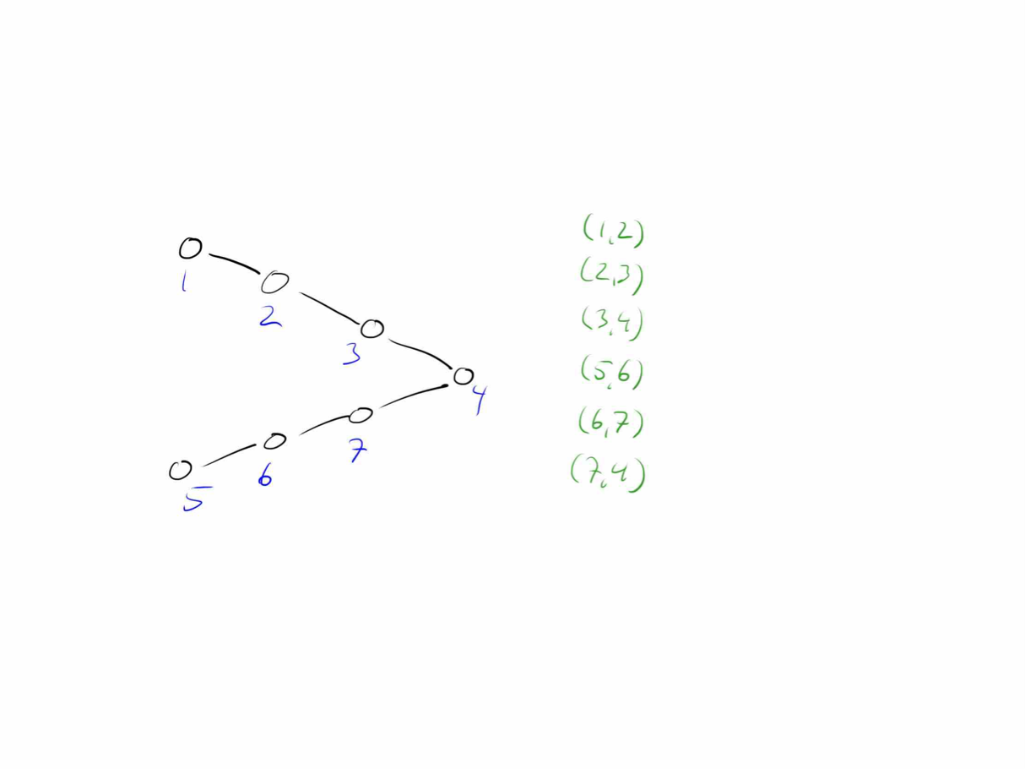
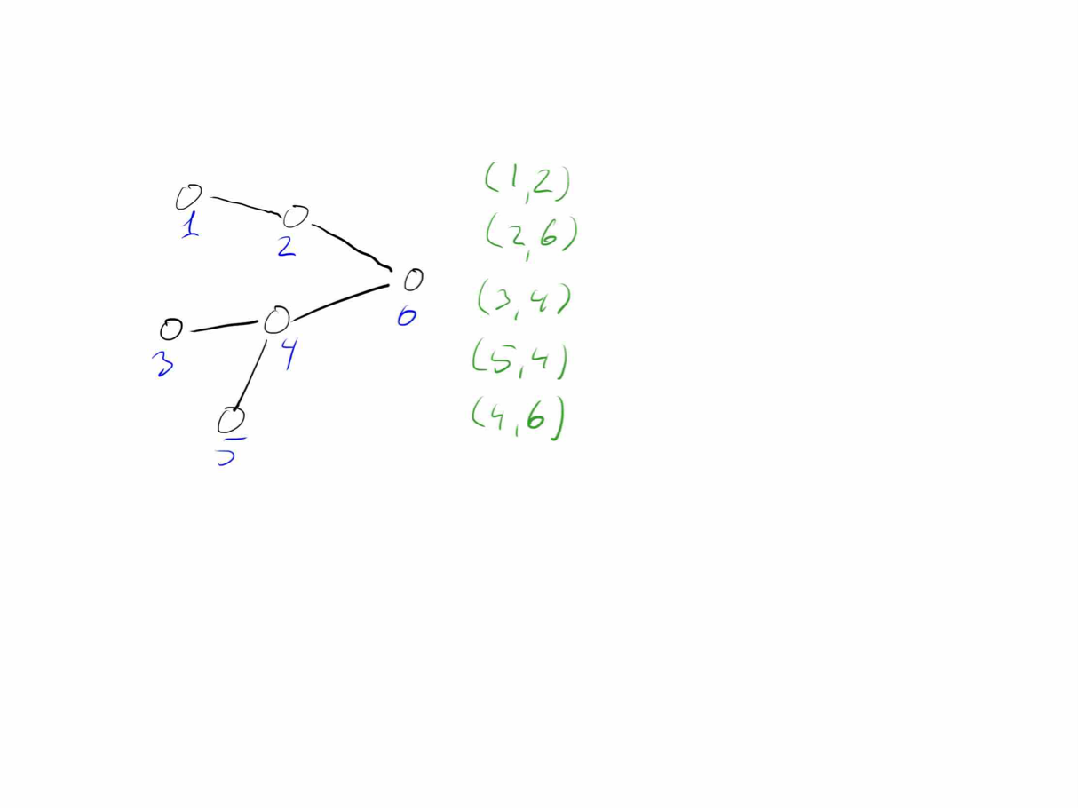
Intermezzo
Run the algorithm on these two graphs:

Slide 47
Correctness

Slide 48
How do we prove correctness?
We prove that all pre- and post-conditions are satisfied through the steps in the algorithm.
We prove that the post-condition of the last step implies that the overall problem is solved.
Correctness is just a special case of post-conditions
Notes:
There isn’t anything special about the post-condition of the entire algorithm and any other post-condition. If the post-condition of the algorithm is what we want it to do, then proving correctness is just an application of proving that post-conditions are met when pre-conditions are met (for the algorithm, this is restrictions on the allowed input).

Slide 49
Termination

Slide 50
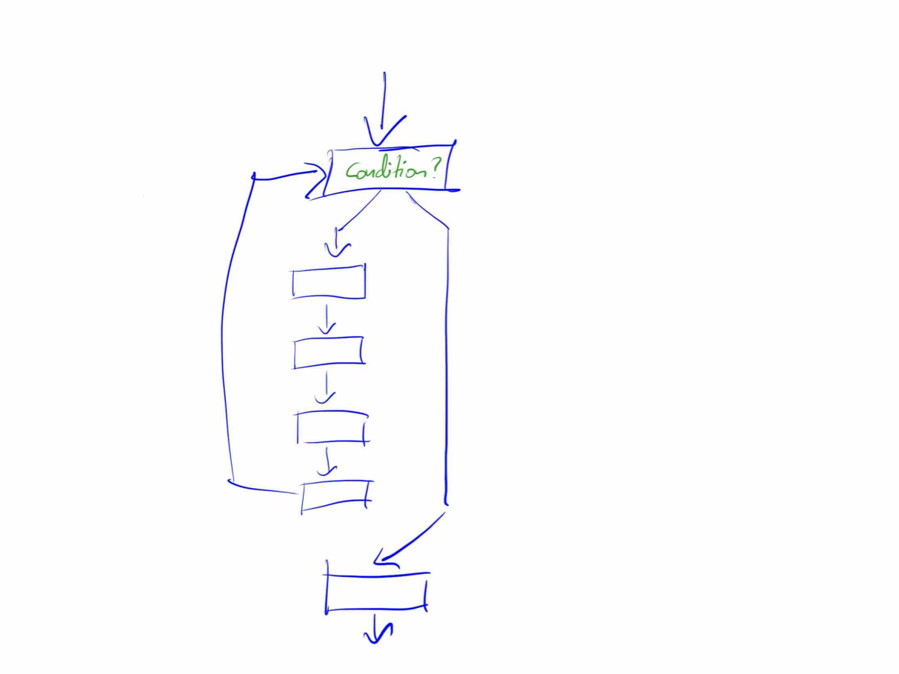

Termination functions:
To ensure that our algorithm
terminations, we add a "termination"
function to each loop.
This is a count-down that should
go down each time we execute the
body of the loop.
Notes:
An algorithm will terminate if all loops in it terminates. So, we can deal with each loop at a time. For a loop, we can associate a termination function. This is just a mapping from the program’s state to a number that is guaranteed to decrease with each iteration of of the loop body and that will eventually reach zero.
It is possible to define functions that decrease in each loop iteration but never reaches zero. You can get asymptotically closer to zero in each iteration. In such cases, we need to be a bit careful with defining the termination function such that it will eventually go below zero. Generally, though, it is relatively easy to come up with a termination function that will be zero when the loop-condition is false and that will decrease in each iteration.

Slide 51
Notes:
For the connectivity problem, the termination function is particularly simple: we use the number of roads that are left to process.
With the for-loops we have seen, we always iterate over a finite sequence of elements, so there we can always use the number of items that remain in the sequence.

Slide 52
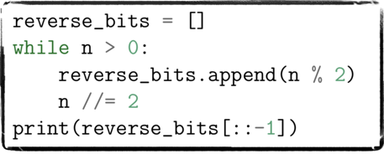
Get the binary representation of a number n
Termination function:
t(n) = n
Notes:
We extract the bits in n in reverse order. We get the least significant bit using modulus and add that to a list, reverse_bits. When we are done with the loop, we reverse this list.
The termination function is simply n.
When it is zero, the loop condition is false, and we leave the loop.
In each iteration, we decrease n — we divide it by two.

Slide 53

Thats it!
Now it is time to do the exercises to test that you now know how to construct algorithms

